Slide 1
Metamorphoses of a Myth
Actaeon in post-Classical Art

Slide 2
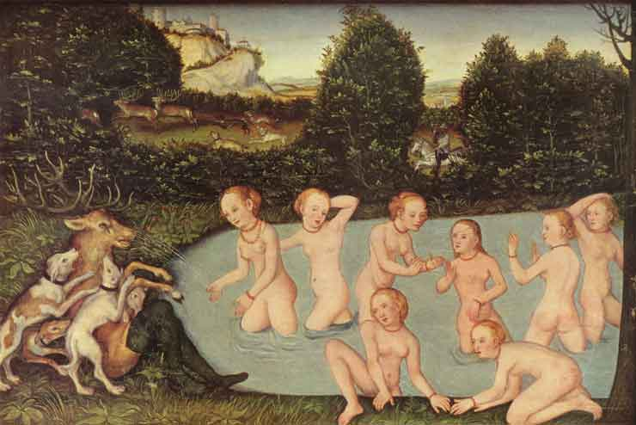
Diana and Actaeon (1533) LUCAS THE YOUNGER CRANACH Oil and tempera on limewood, 32 x 73 cm Wadsworth Athenaeum, Hartford, Conn.

Slide 3
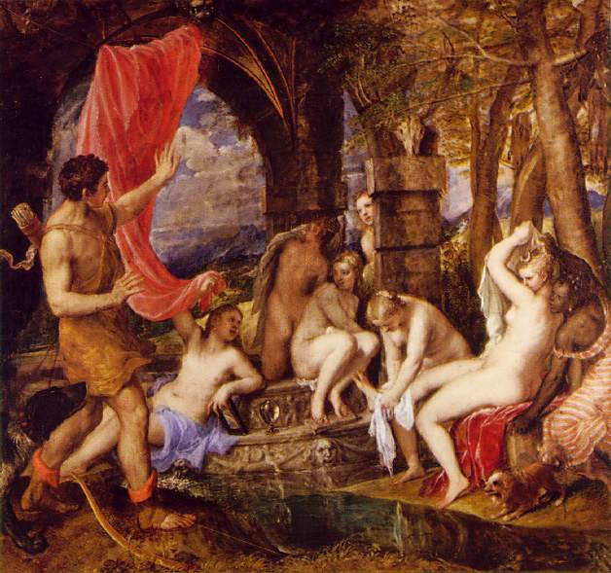
Titian Diana and Actaeon 1559 Oil on canvas 190.3 x 207 cm National Gallery of Scotland
Edinburgh

Slide 4
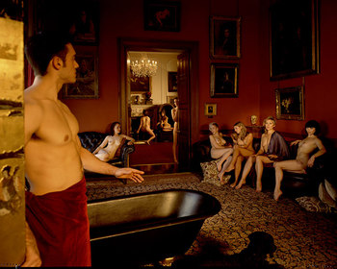
Titian's Diana and Actaeon
recreated by Tom Hunter BBC 2008 with SEX And The City's maneating star Kim Cattrall looks stunning as she poses semi-naked in a recreation of Titian's masterpiece Diana and Actaeon.

Slide 5
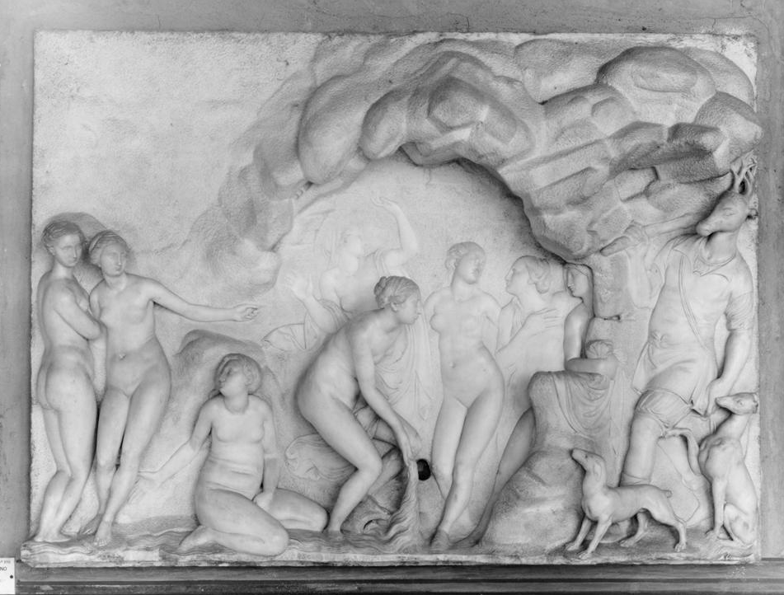
Diana and Actaeon Francesco Mosca c. 1530-1578 marble Museo nazionale del Bargello (Florence, Italy)

Slide 6
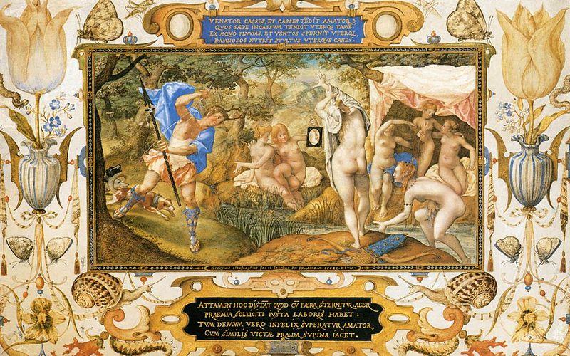
Diana and Actaeon (1597)
Joris Hoefnagel (1542–1600)
Distemper and gold on vellum mounted on panel
Height: 220 mm (8.66 in). Width: 339 mm (13.35 in).
Louvre Museum

Slide 7
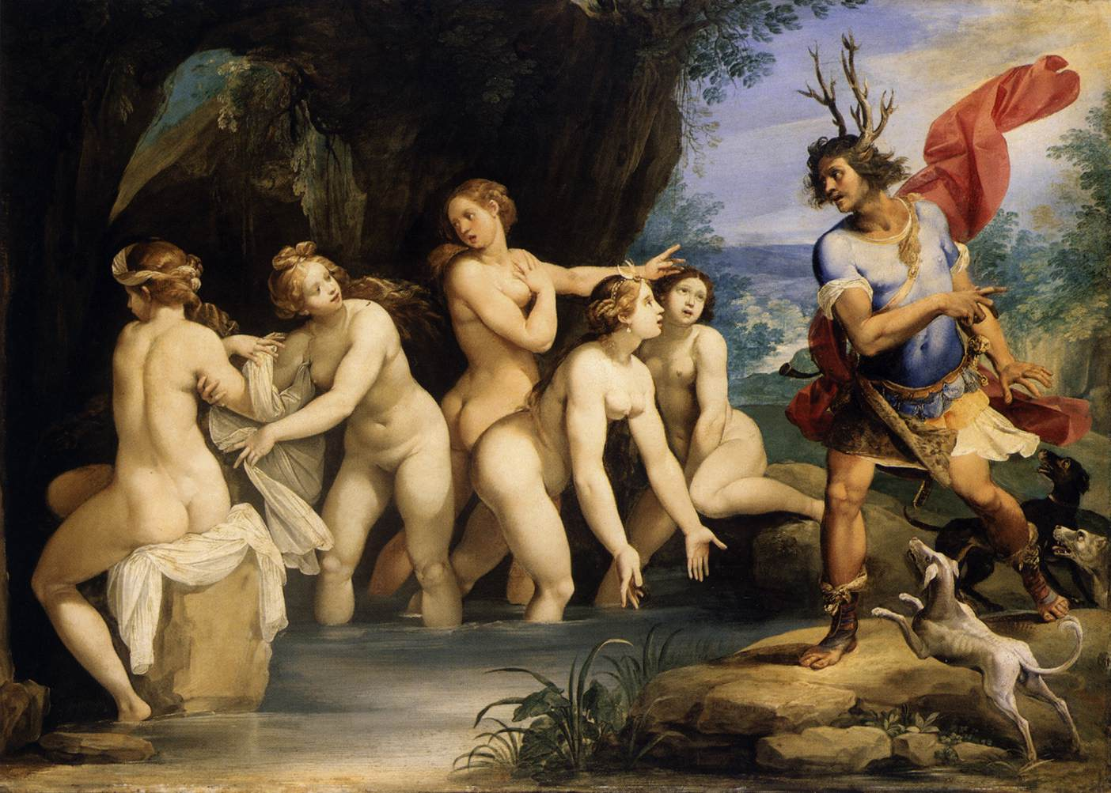
Diana and Actaeon (1603-1606)
CESARI, Giuseppe (Italian; b. 1568, Roma; d. 1640, Roma)
Oil on copper, 50 x 69 cm
Museum of Fine Arts, Budapest

Slide 8
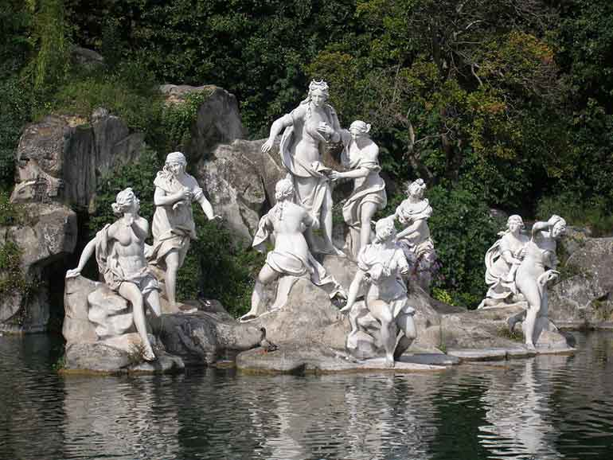
Diana and Actaeon, Luigi Vanvitelli ( 1700 Napoli - 1773 Caserta)
c. 1770 (designed)
Marble, over life-size
Royal Residence, Caserta, Italy

Slide 9
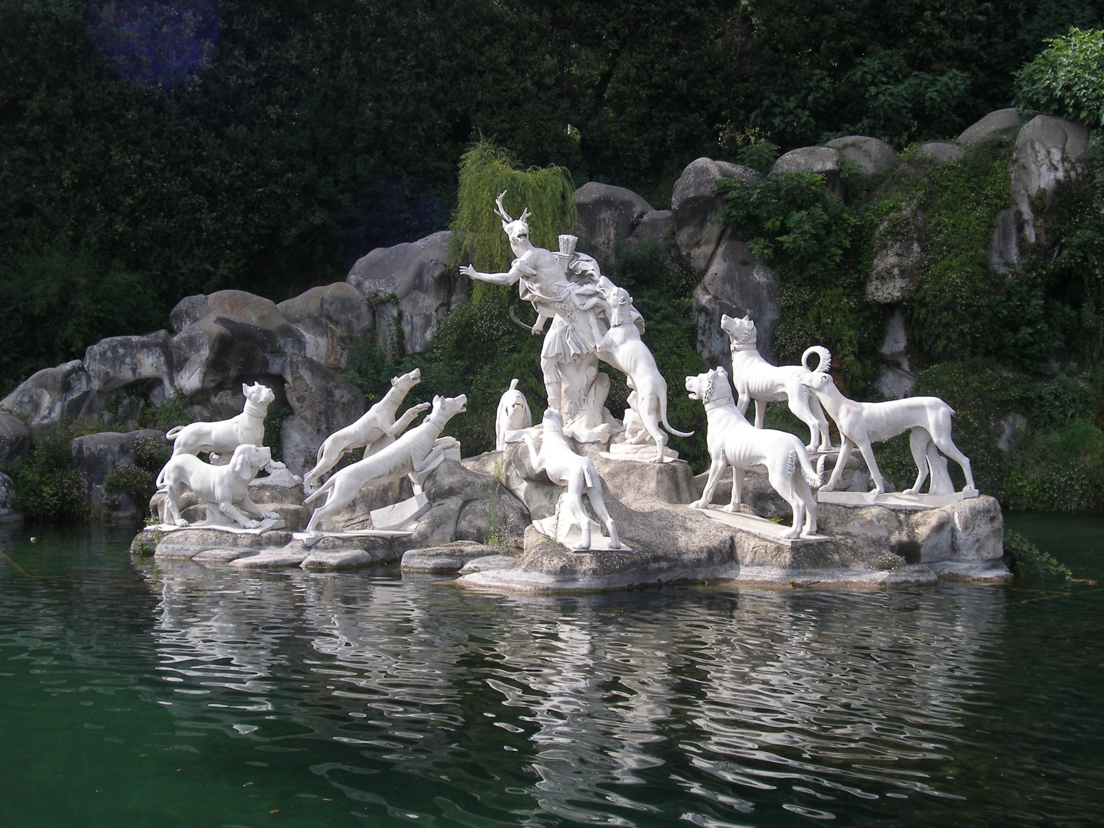
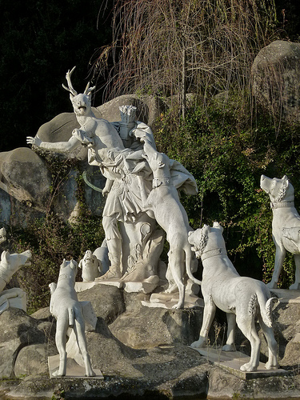
The Fountain of Diana and Actaeon
sculptures by Paolo Persico, Brunelli, Pietro Solari
c.1770
Royal Residence, Caserta, Italy

Slide 10
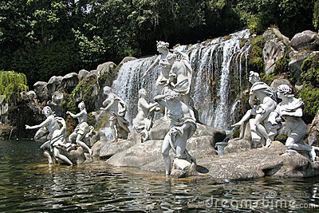
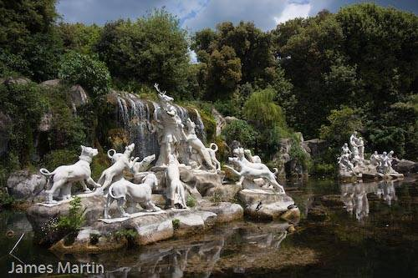

Slide 11
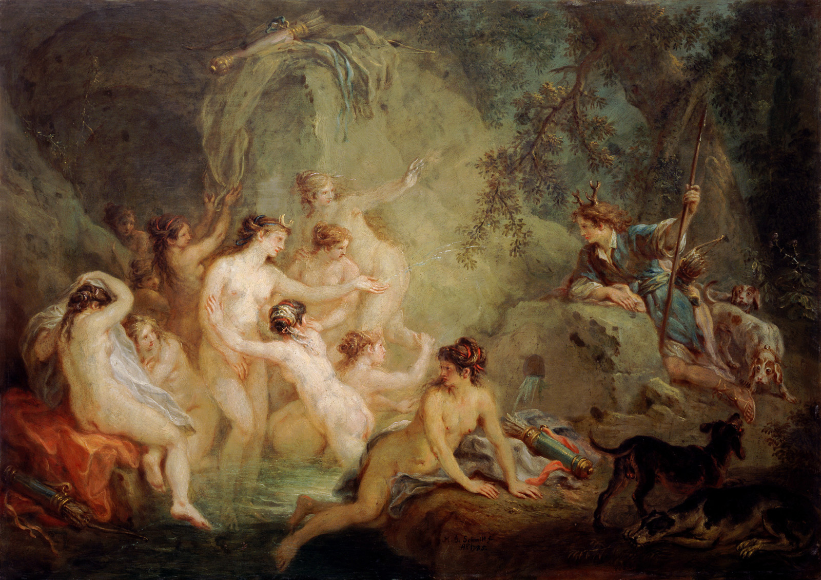
\
Diana and Actaeon (1785) MARTIN JOHANN SCHMIDT (1718-1801)
Oil on copper, 77 x 55 cm National Gallery of Slovenia, Ljubljana

Slide 12
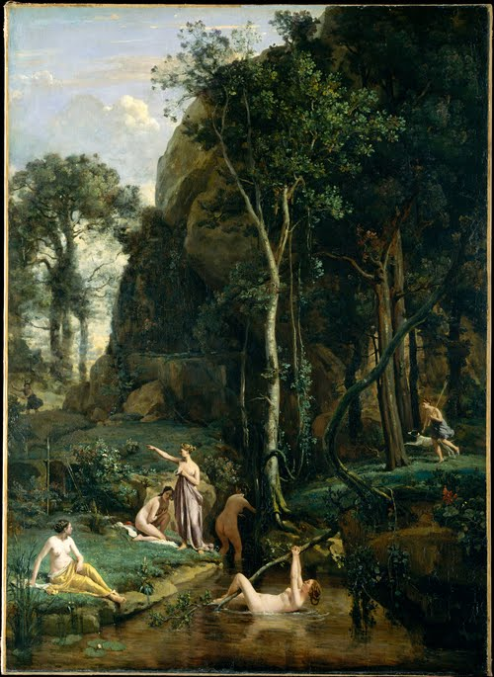
Diana and Actaeon, 1836 Jean-Baptiste-Camille Corot (French, 1796–1875) Oil on canvas; 61 5/8 x 44 3/8 in. (156.5 x 112.6 cm) Robert Lehman Collection, 1975 (1975.1.162)
New York Metropolitan Museum of Art

Slide 13
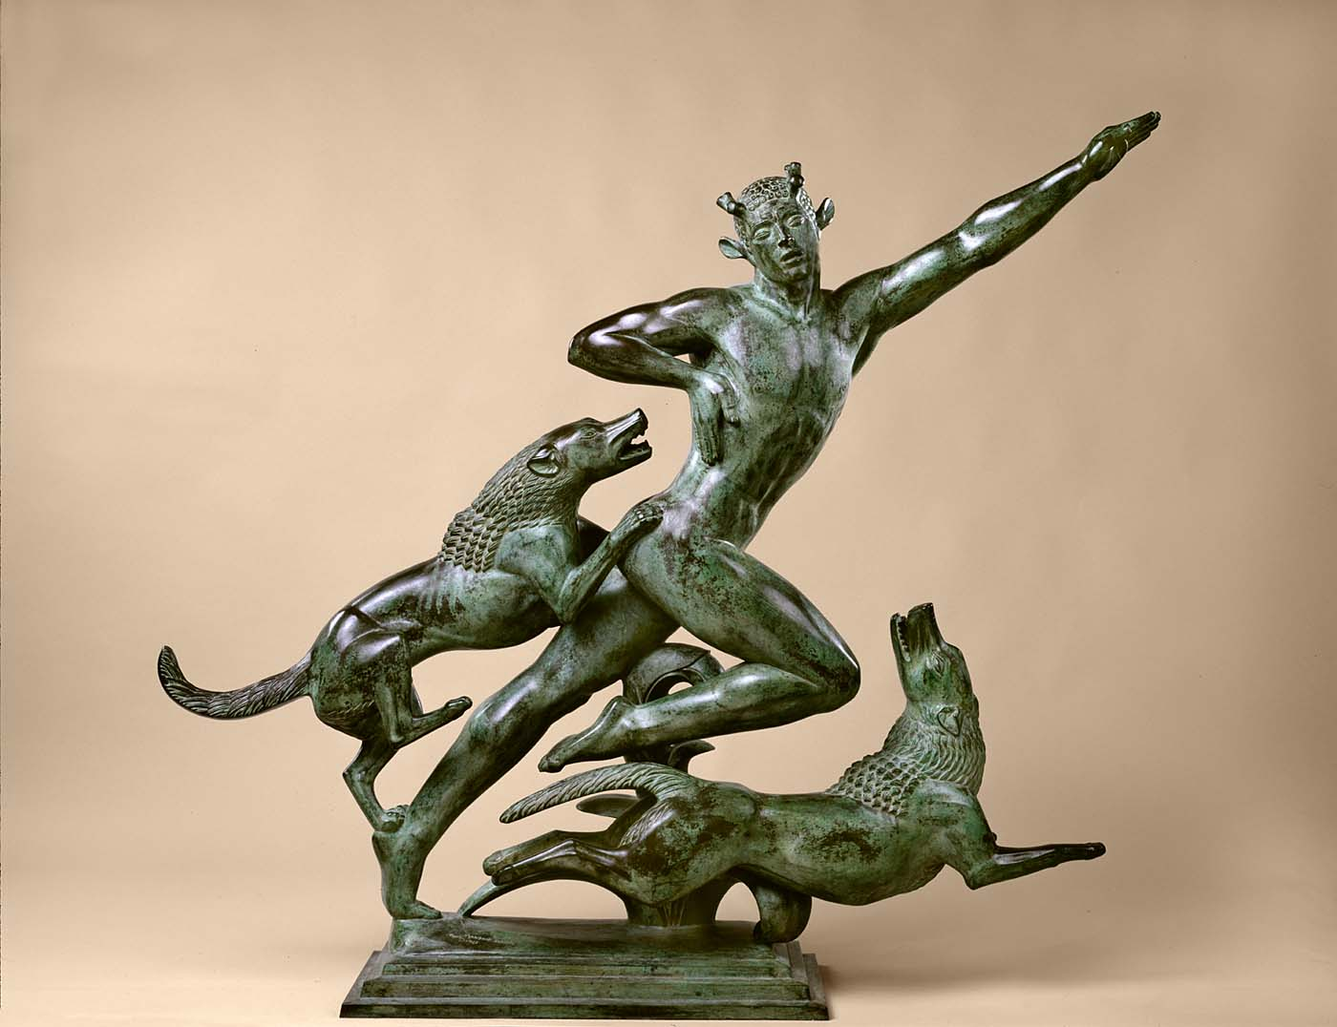
Actaeon (# 1), 1925. Paul Howard Manship(1885-1966)
Bronze, 48 x 52 in. Smithsonian American Art Museum
Gift of the artist 1965.16.33.

Slide 14
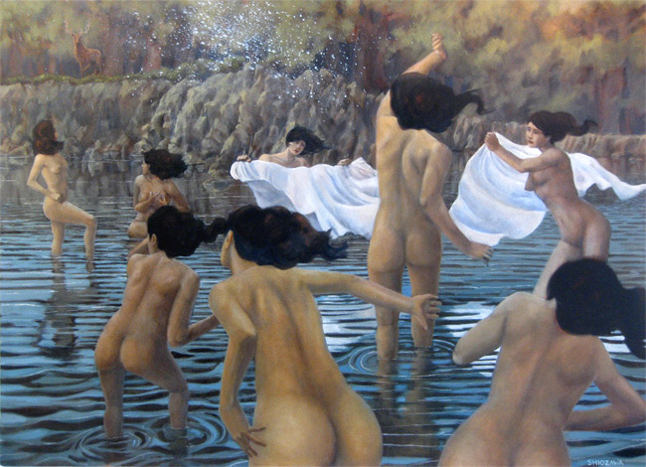
Jun-Pierre Shiozawa 2009
From Minneapolis, USA
Currently residing in Paros, Greece

