Slide 1
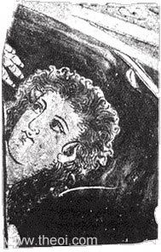
Callisto
Callisto (?), Apulian red figure vase fragment C4th B.C., Museum of Fine Arts, Boston
http://www.theoi.com/Heroine/Kallisto.html
http://www.theoi.com/Gallery/O15.1.

Slide 2
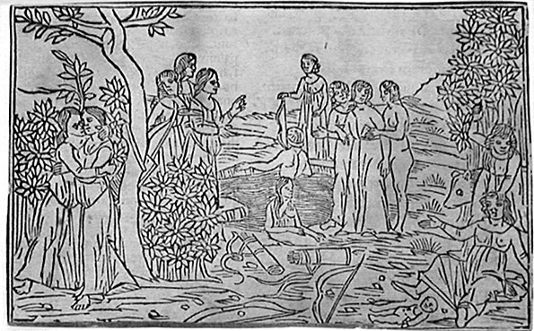
Venetian School, c. 1500. Diana and Callisto. Original woodcut, c. 1500, Venice.

Slide 3
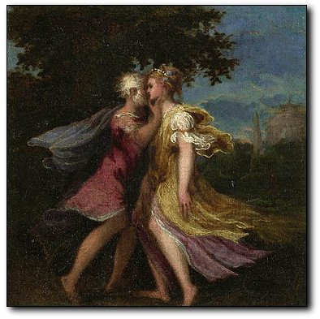
Jupiter and Callisto
Andrea Schiavone
Jupiter seducing Callisto, about 1550 The National Gallery, London.

Slide 4
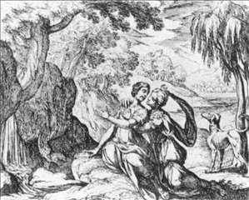
Callisto and Jupiter
ANTONIO TEMPESTA Date :1606 Technique :Engraving, 97 x 115 mm Type :mythological Form :graphics

Slide 5
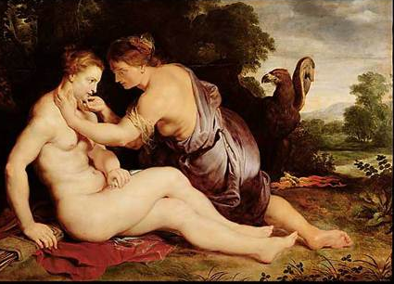
Jupiter and Callisto, 1613
by Peter Paul Rubens
Location: Staatliche Kunstsammlungen, Kassel, Germany
Painting Technique: oil on canvas
Picture content: Nude

Slide 6
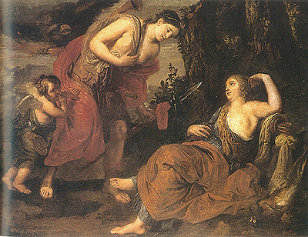
"JUPITER AND CALLISTO“ (1676)
ERASMUS QUELLINUS IN PALMA DE MALLORCA
Private Collection

Slide 7
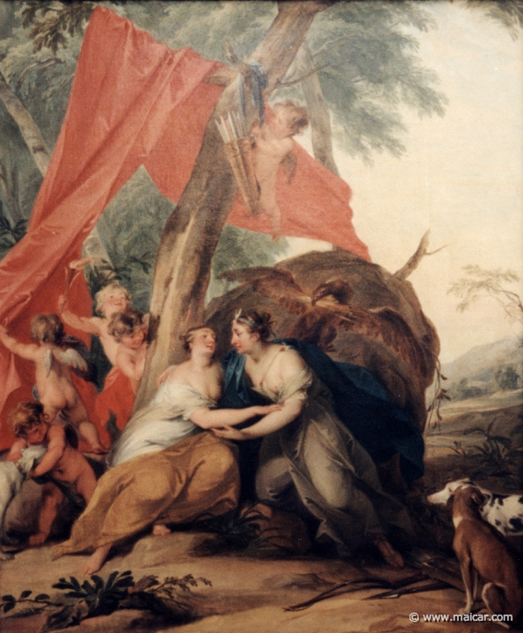
Jacob de Wit 1695-1754: Jupiter disguised as Diana, seducing the nymph Callisto. Rijksmuseum, Amsterdam.

Slide 8
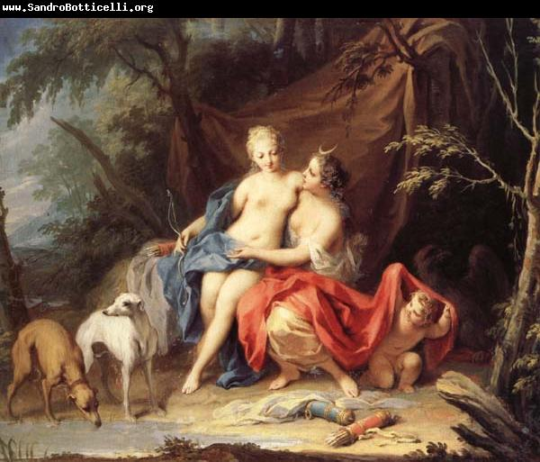
Jacopo Amigoni (1682–1752),
This artist also did “Juno Receiving the Head of Argus”

Slide 9
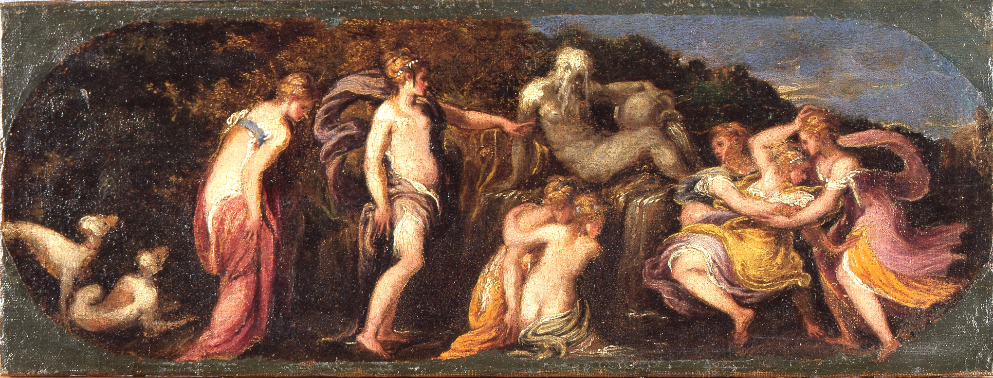
Callisto and Diana
Schiavone, Diana and Callisto
c.1550
Amiens, Musée de Picardie (MPLav1894-241)

Slide 10
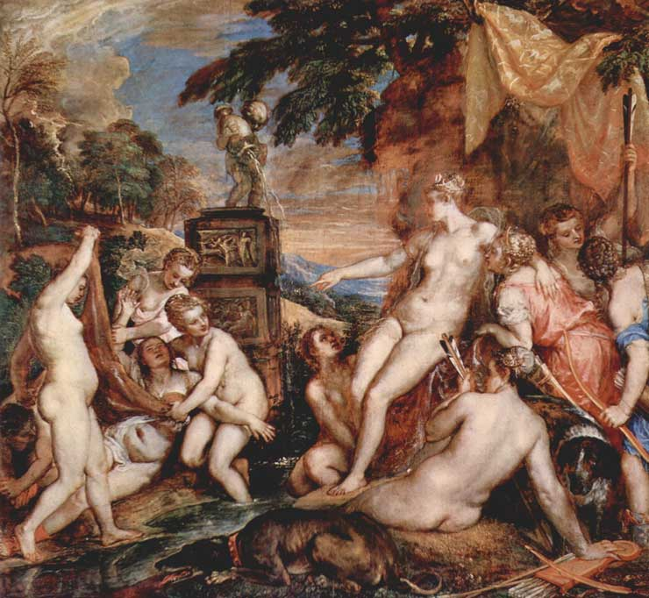
Titian (1490–1576)
Title
English: Diana and Callisto
Date
1556-59
Medium
Oil on canvas
Dimensions
English: ( H 187 x W 204.5 cm)
Current location
English: National Gallery of Scotland
English: Edinburgh, Scotland

Slide 11
Titian’s Later Mythologies
Bibliographic Information
Titian's Later Mythologies
W. R. Rearick
Artibus et Historiae
Vol. 17, No. 33 (1996) (pp. 23-67)
Abstract
Titian painted a celebrated cycle of six mythological subjects, works he himself called poesie, for Philip II of Spain between 1553 and 1562; today four of this set survive, including the newly rediscovered first version of the "Venus and Adonis" (Lausanne, private collection). What is less well known is that between 1561 and 1568 Titian painted a second set of poesie that was offered to, but not bought by, the Emperor Maximilian II in 1568. Today, we can identify four of these later pictures, two of them usually thought to belong to the first set. In them, the workshop participation is more evident, but some passages belong with the most powerful evocations of Titian's late style. This revised evaluation of Titian's later poesie we can now add a ceiling painting, the "Rap of Ganeymede" (Kreuzlingen, Heinz Kisters collection) that has not previously been discussed in the literature on Titian.
Copy of the Article: http://department.monm.edu/classics/Courses/Clas230/Art/Titian'sLaterMythlogies.pdf

Slide 12
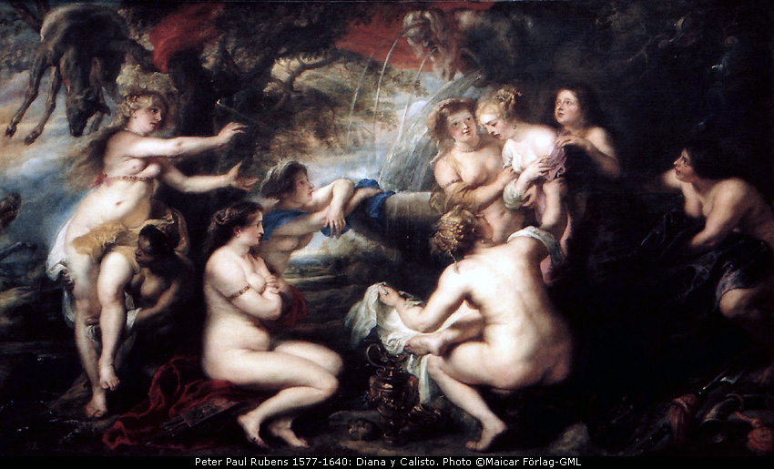
Artemis (left) discovers Callisto's pregnancy. 9821: Peter Paul Rubens 1577-1640: Diana y Calisto. Museo Nacional del Prado.

Slide 13
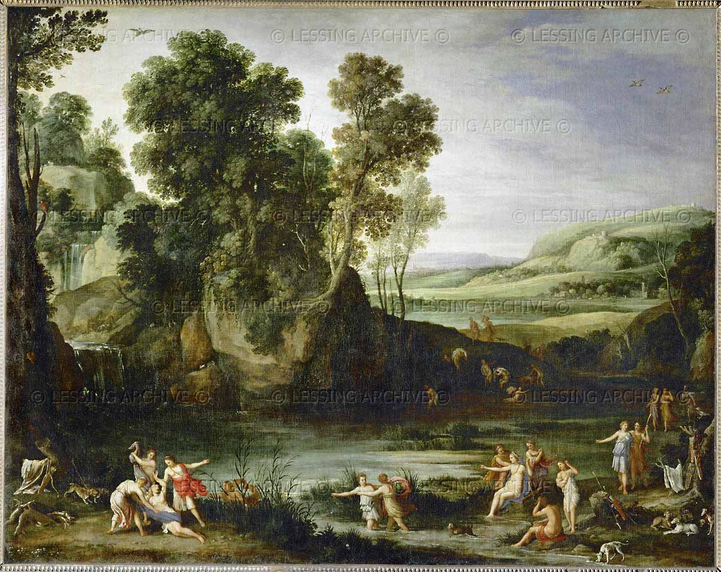
BAROQUE PAINTING 17TH Cent.
Bril,Paul
Diane decouvrant la grossesse de Callisto. Diana learns of the pregnancy of the nymph Callisto. Callisto, seduced by Zeus, breaks her vows of eternal chastity and gives birth to a son, Arkas. Canvas, 161 x 206 cm INV. 207 Louvre, Departement des Peintures, Paris, France

Slide 14
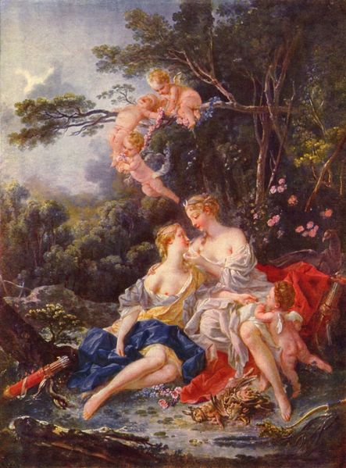
Artist: Francois Boucher
Completion date: 1744
Style: Rococo
Genre: mythological painting
Technique: Oil
Material: Canvas
Dimensions: 72 x 98 cm
Gallery: Pushkin Museum
Moscow, Russia

Slide 15
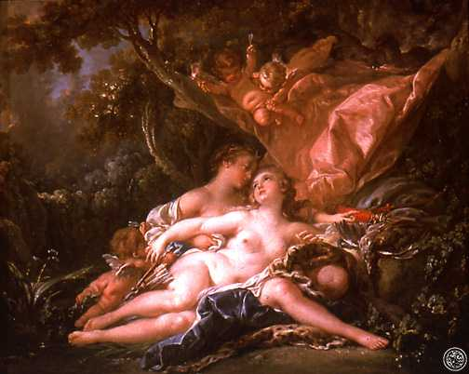
In the painting "Jupiter In the Guise of Diana and the Nymph Callisto," by Francois Boucher (1759), Jupiter pretends to be Diana and whispers in Callisto's ear. the Nelson-Atkins Museum of Art, Kansas City, Missouri.

Slide 16
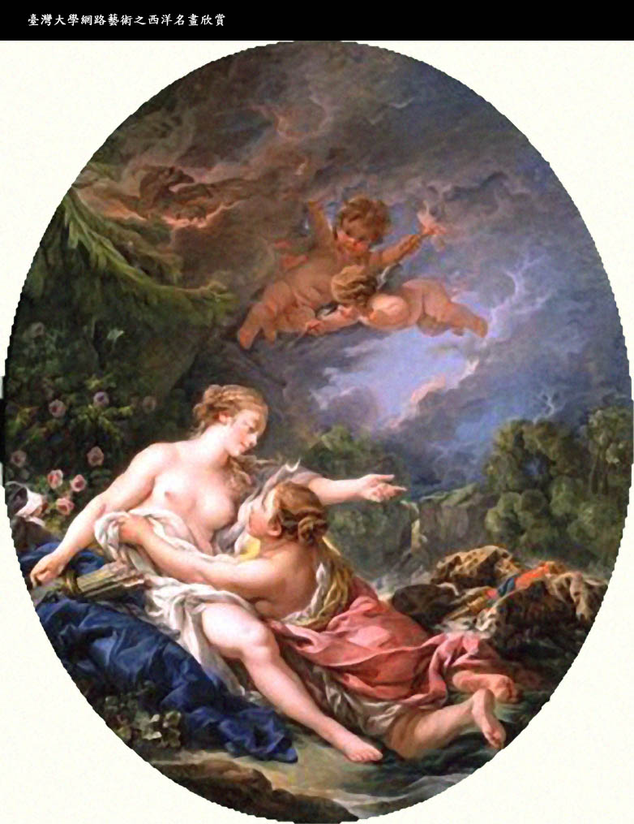
François Boucher (1703 - 1770)
Jupiter and Callisto
France
1769
Painting
Oil on canvas
Image size: 160 x 129 cm, oval
Signature: 'f. Boucher / 1769
The Wallace Collection, London

Slide 17
Boucher’s Callistos

Slide 18
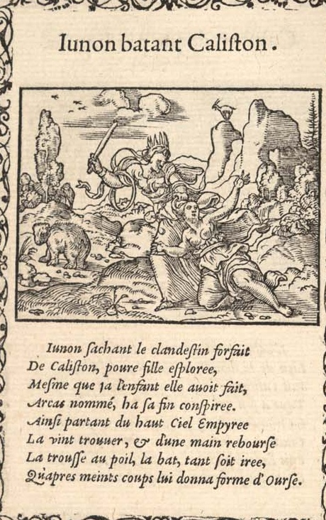
Salomon-Solis Illustration Cycles1557

Slide 19
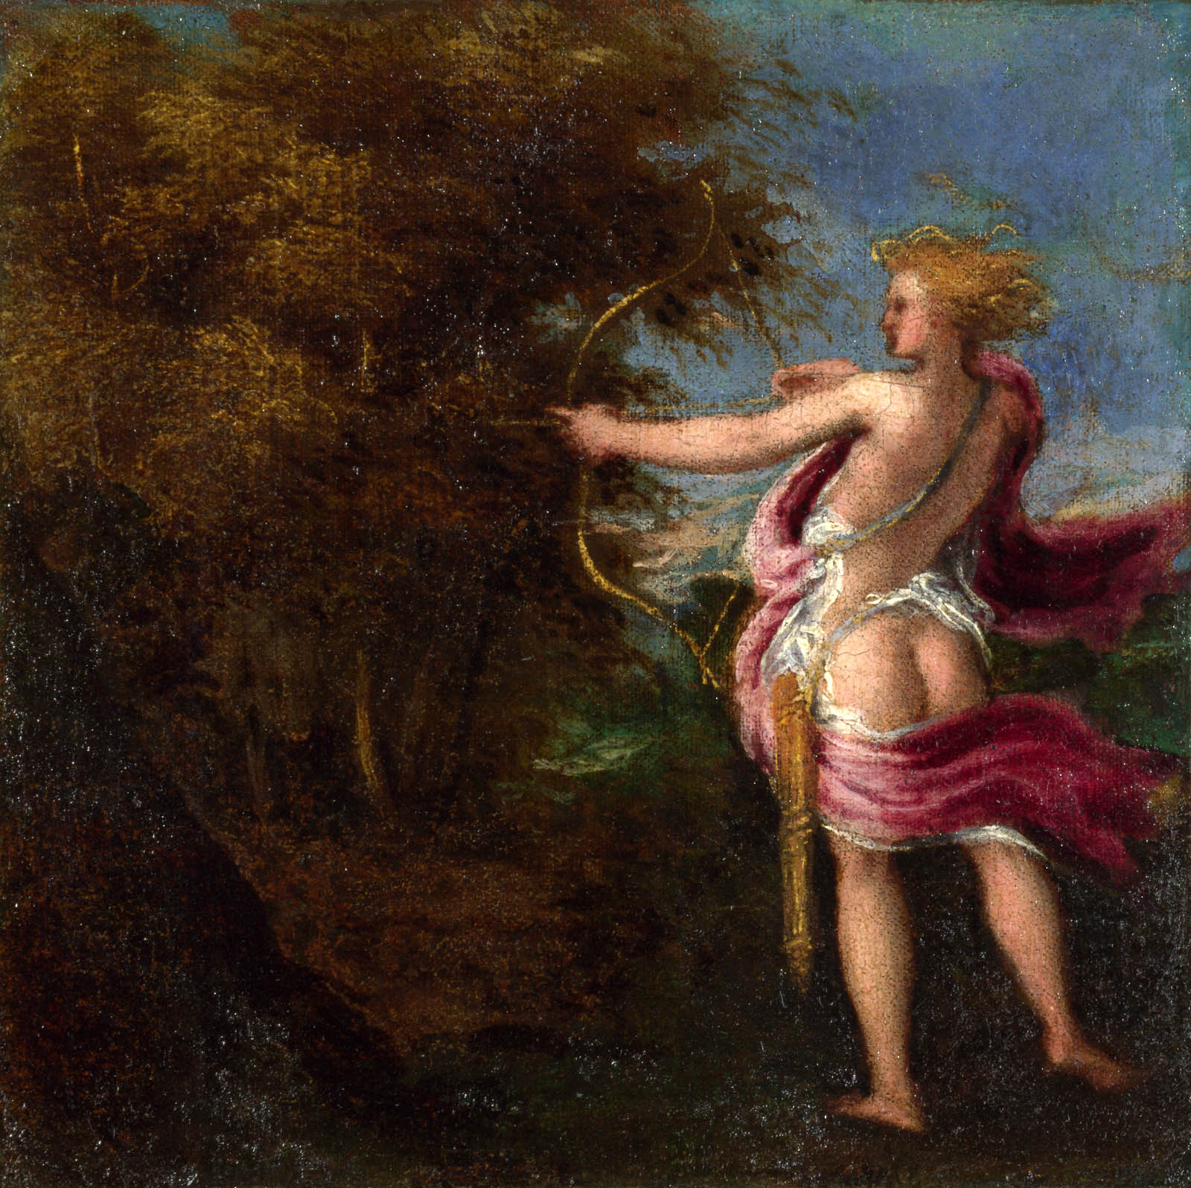
Andrea Schiavone
Arcas Hunting
about 1550 The National Gallery, London.

Slide 20
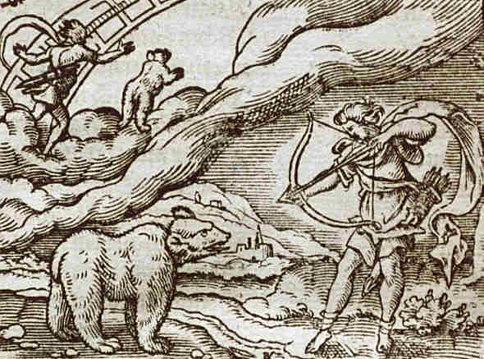
From the University of Virginia website: The Renaissance Reception of Ovid in Image and Text, featuring a 1563 edition of Ovid's Metamorphoses illustrated by by Virgil Solis and others.

Slide 21
More Useful Websites
http://www.lilithgallery.com/arthistory/greekroman/Achilles-to-Zephyr-List-of-Greek-Roman-Art.html
http://mini-site.louvre.fr/venise/en/exhibition/prologue.html
http://www.spaightwoodgalleries.com/Pages/Venice_1500_Myth.html
http://etext.virginia.edu/latin/ovid/ovidillust.html
http://etext.virginia.edu/latin/ovid/metamorphosesdovide.html
http://etext.virginia.edu/latin/ovid/ovidillust.html

