Slide 1
Infant Hercules and the Snakes

Slide 2
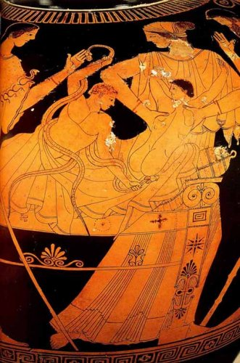
Heracles and Iphicles
(Heracles strangling two snakes in the crib)
Red figure pottery, 470 BC
Musée du Louvre, Paris

Slide 3
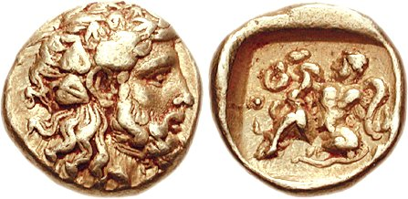
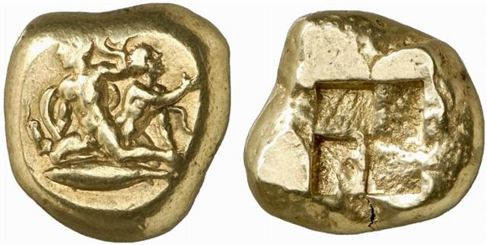
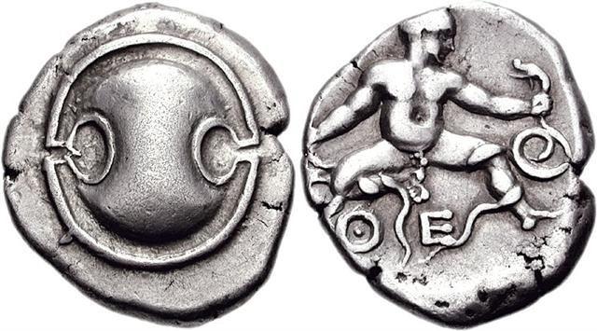
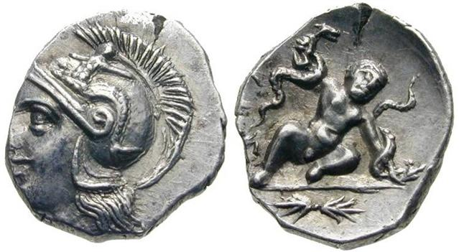
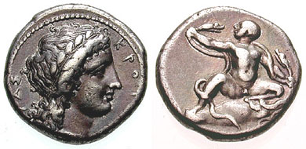
BOEOTIA, Thebes. Circa 395 BC. Hemidrachm Electrum, Dionysos, infant Herakles
MYSIA, Cyzicus. Stater, EL ca 430-415 BC Heracles and Iphicles
BOEOTIA, Thebes. Circa 405-395 BC. AR Stater 21mm
BRUTTIUM, Kroton. Circa 370 BC. AR Nomos
Calabria, Tarentum. Diobol, about 250 bc 11-12mm

Slide 4
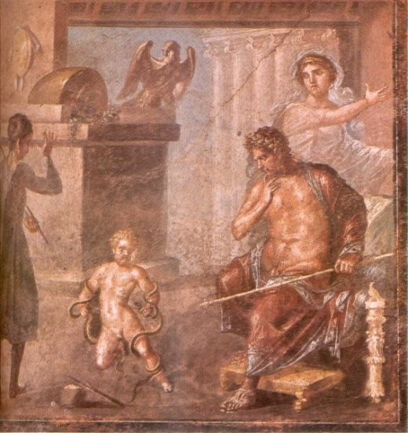
Hercules strangles the serpents
Painting from the House of the Vettii, Pompeii.
62-79 AD.

Slide 5
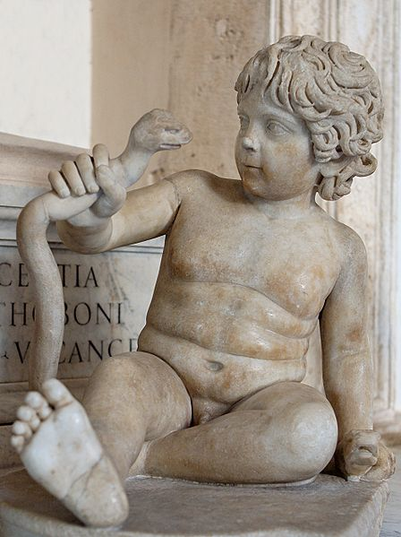
Young boy portrayed as Hercules choking the snakes
Rome, Capitoline Museum
Second half of 2nd century AD
Marble

Slide 6
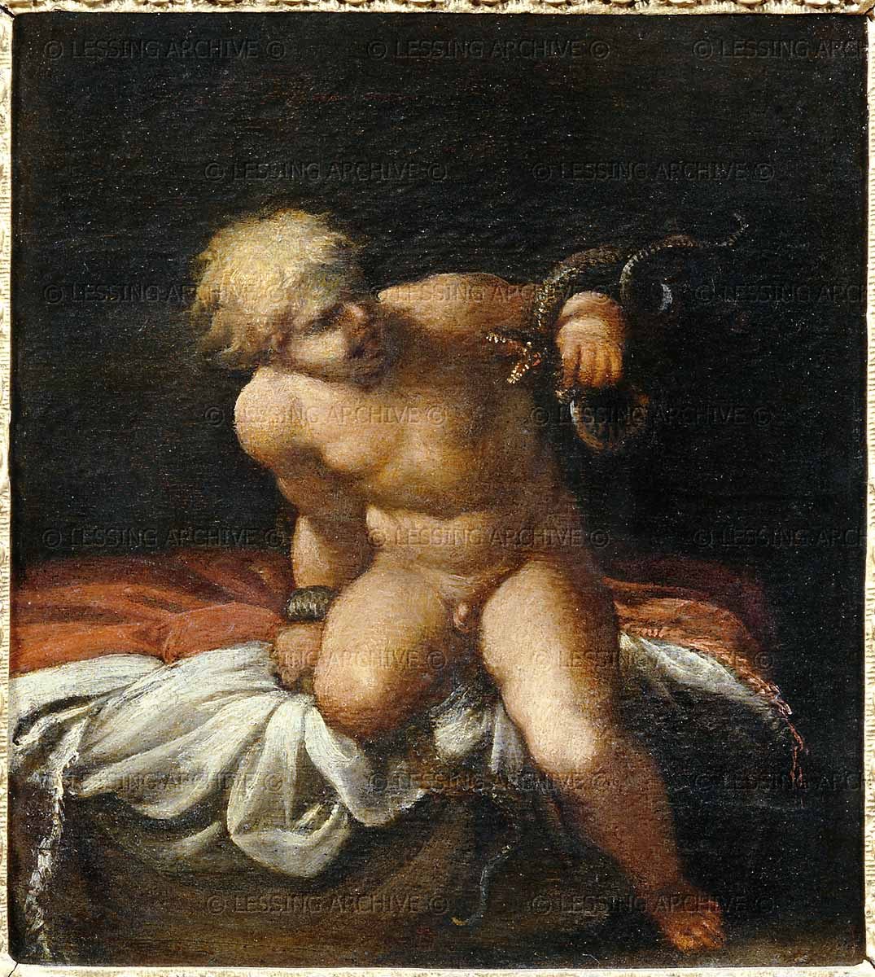
Annibale Carracci
1599-1600
Louvre Paris, France

Slide 7
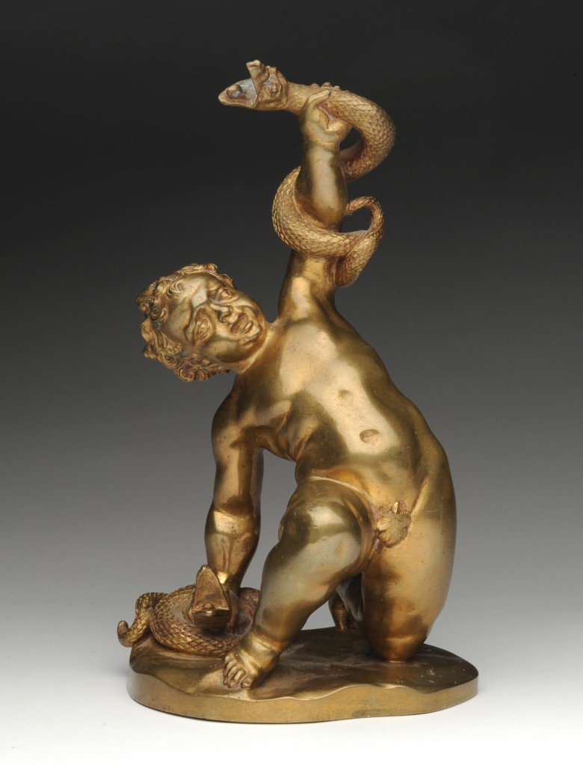
Anonymous French Artist
1700
Bronze

Slide 8
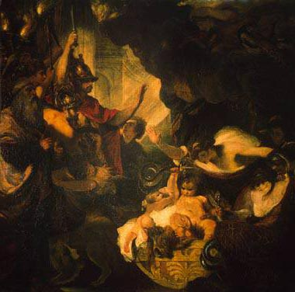
The Infant Hercules Strangling the Serpents
Sir Joshua Reynolds
This painting was commissioned by Catherine the Great in 1785
the State Hermitage Museum

Slide 9
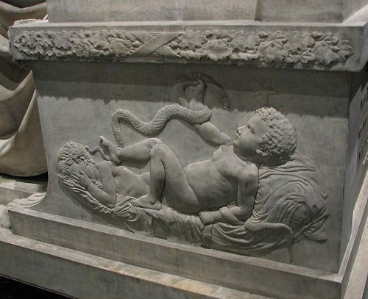
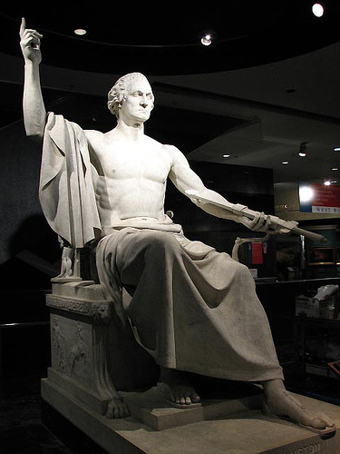
George Washington
Horatio Greenough.
(1840) Centennial of Washington’s Birth
National Museum of American History

