Slide 1
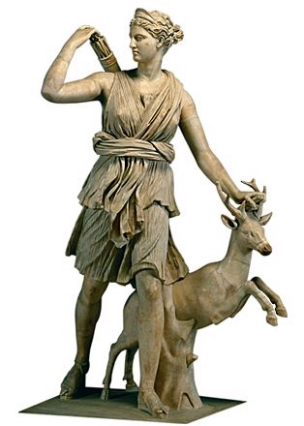
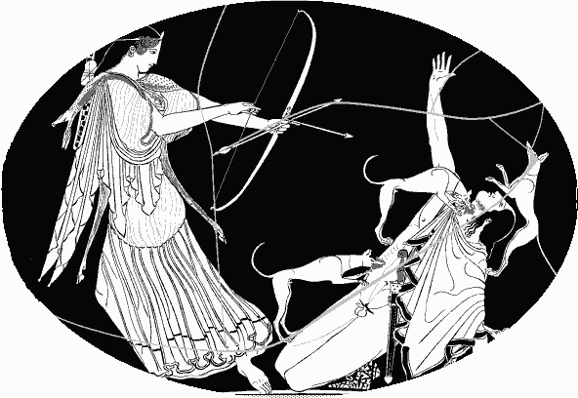
Diana (and Actaeon)

Slide 2
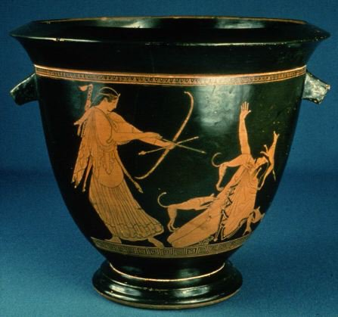
Pan Painter. Artemis Slaying Actaeon. c. 470 BCE. Red-figure decoration on a bell krater. Ceramic, height of krater 14 5/8" (37 cm). Museum of Fine Arts, Boston James Fund and by Special Contribution.

Slide 3
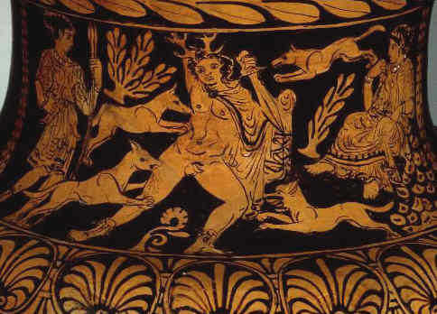
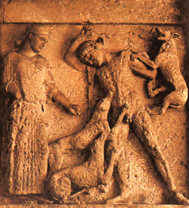
Temple, Selinus, Sicily

Slide 4
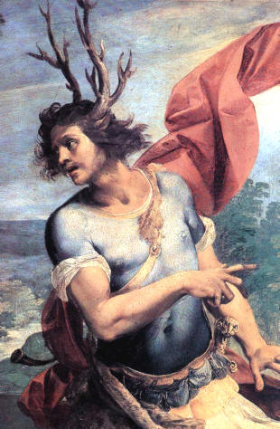
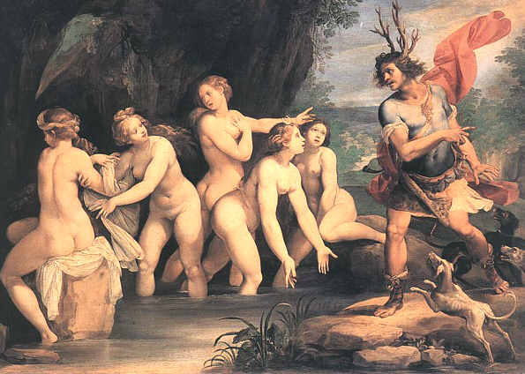
Cavilere d’Arpino
1603-1606

Slide 5
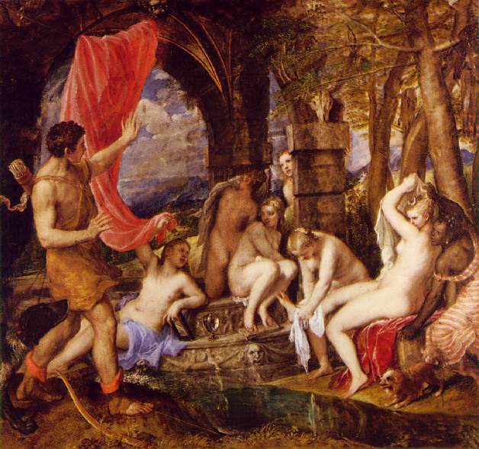
''Actaeon Surprising Diana (Artemis) in the bath'', Titian, 1556-59, for Philip II (National Gallery of Scotland)

Slide 6
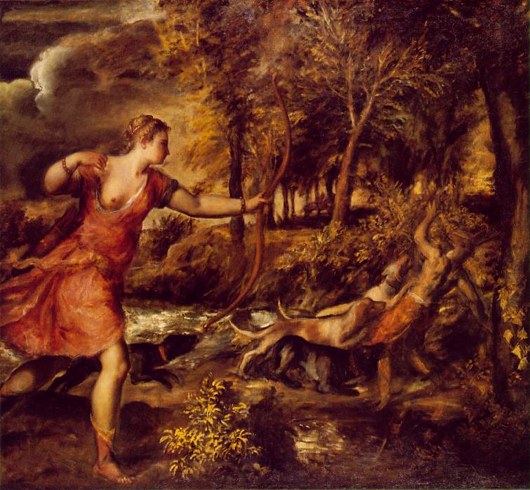
Titian Death of Actaeon 1562 Oil on canvas 179 x 189 cm National Gallery, London

Slide 7
Calum Colvin
1961-

