Slide 1
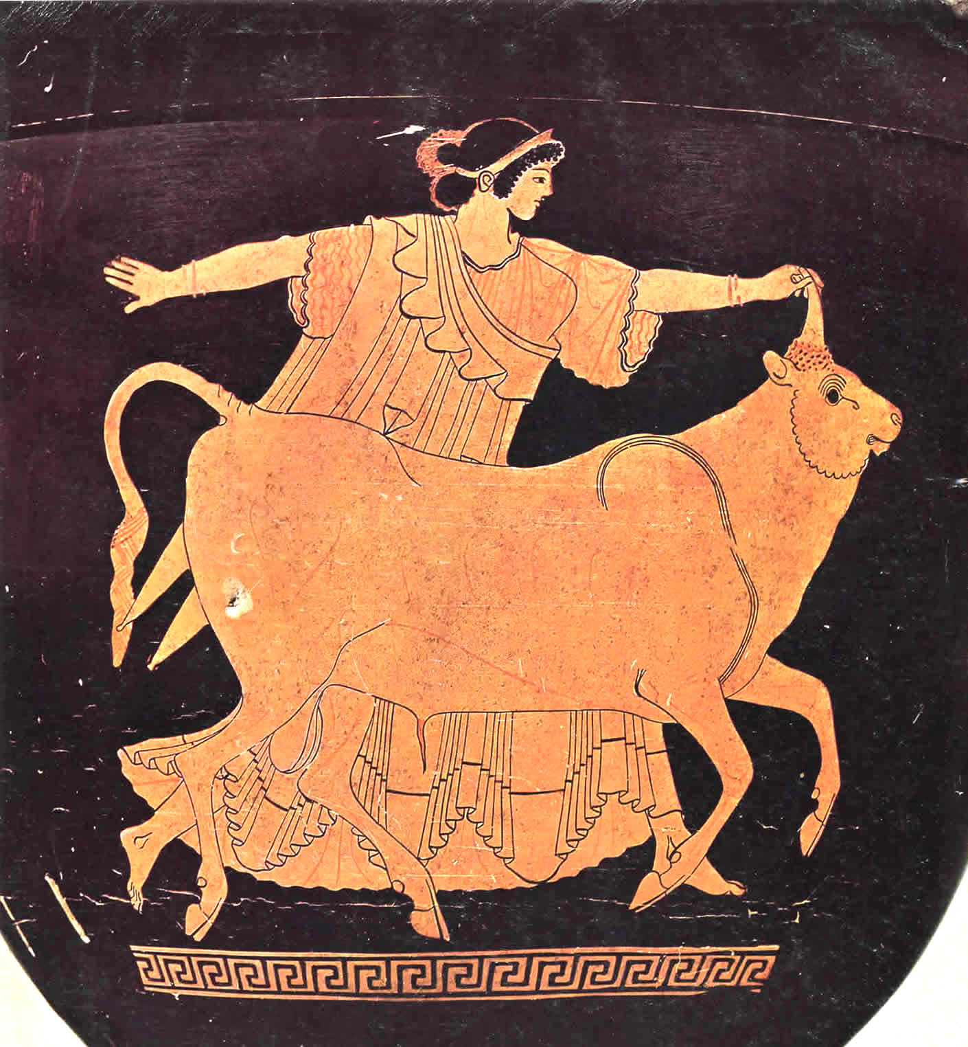
“Chosen Women:” Europa and Io

Slide 2
Europa and the Bull - Red-Figure Stamnos, Tarquinia Museum, circa 480 BCE

Slide 3
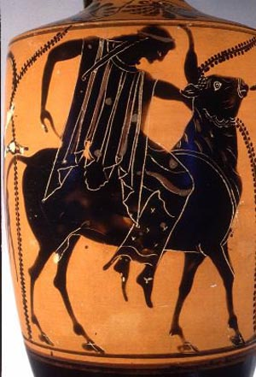
Archaic Black-Figure version of Europa and the Bull from the late 6th c. BCE

Slide 4
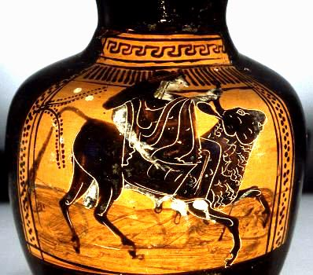
Europa and the Bull, Black Figure Oinochoe circa 510-500 BCE, influenced by Athena Painter, former Robinson Collection, now University of Mississippi, MISS-1977-03-73

Slide 5
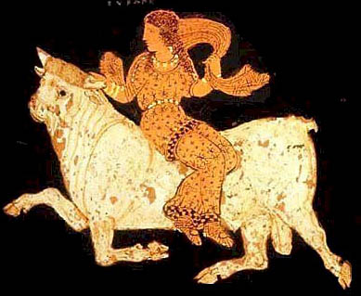
Detail: Europa and the Bull, Asteas, Paestan circa 340 BCE, formerly Getty Museum, now Italy

Slide 6
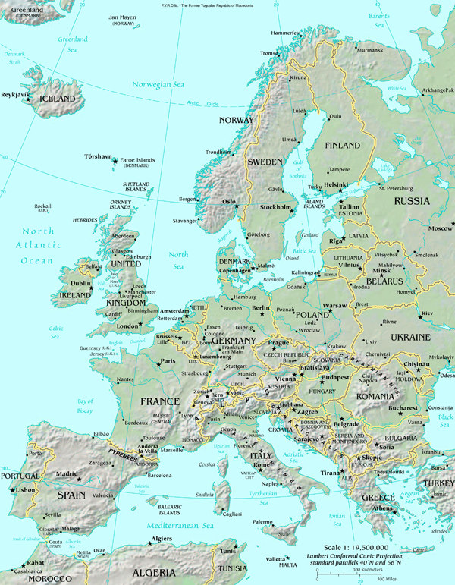
Eponymous Heroine
CRETE

Slide 7
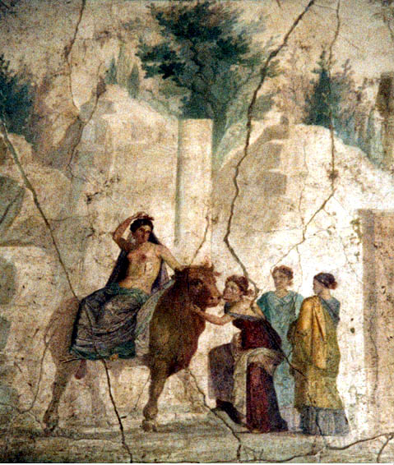
Europa and the Bull, Roman Wall Painting, House of Fatal Love, Pompeii, c. 1st c. CE

Slide 8
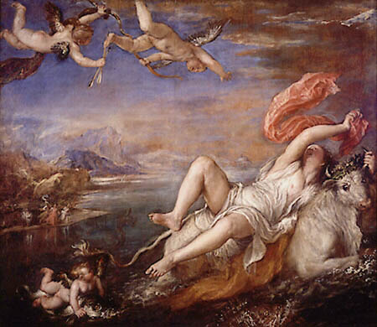
Titian, Europa, circa 1575-80, Isabella Stewart Gardner Museum, Boston

Slide 9
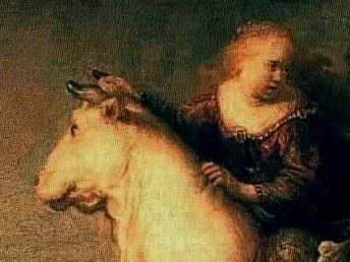
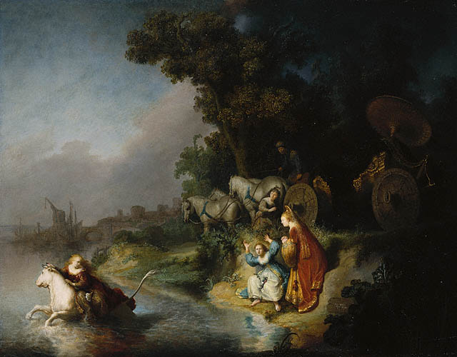
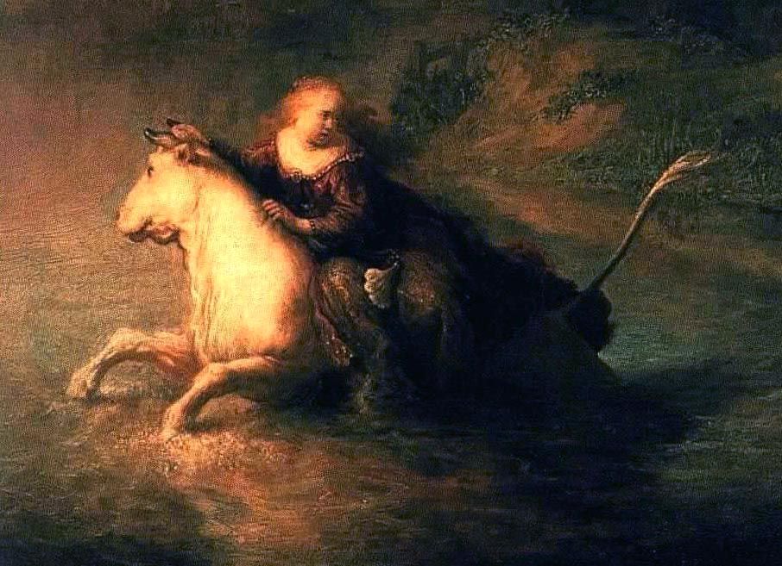
Rembrandt: THE ABDUCTION OF EUROPA (1632, Getty Museum, 61 x 78 cm)

Slide 10
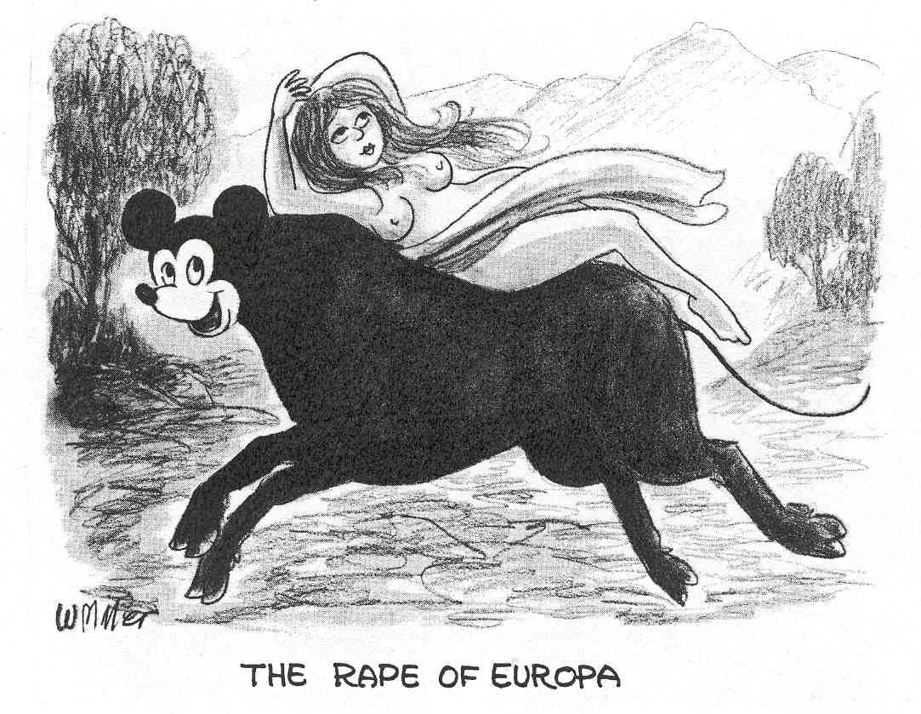

Slide 11
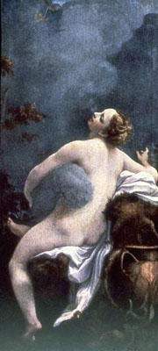
Io
Correggio (Antonio Allegri)
(c. 1489-1534)

Slide 12
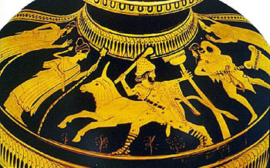
Io
red figure vase painting of Io (as a cow) and Argus, with Hermes approaching.

Slide 13
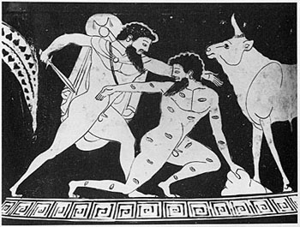
red figure vase painting showing Hermes killing the many-eyed Argus, as Io (the cow) stands to the left.

Slide 14
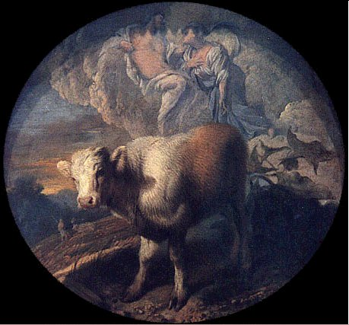
Casdiglione, Giovanni Benedetto 1609-1663/65

Slide 15
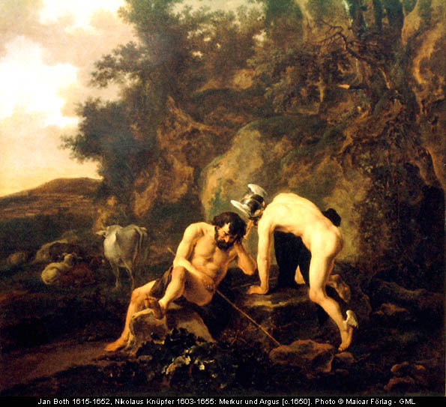

Slide 16
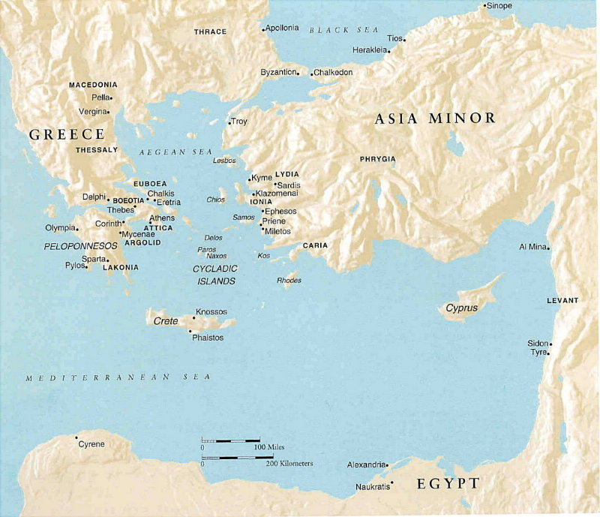
Bosporus (Cow Sea)

Slide 17
