Slide 1
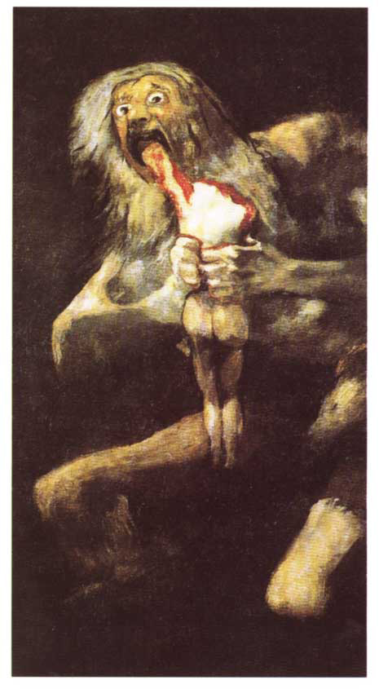
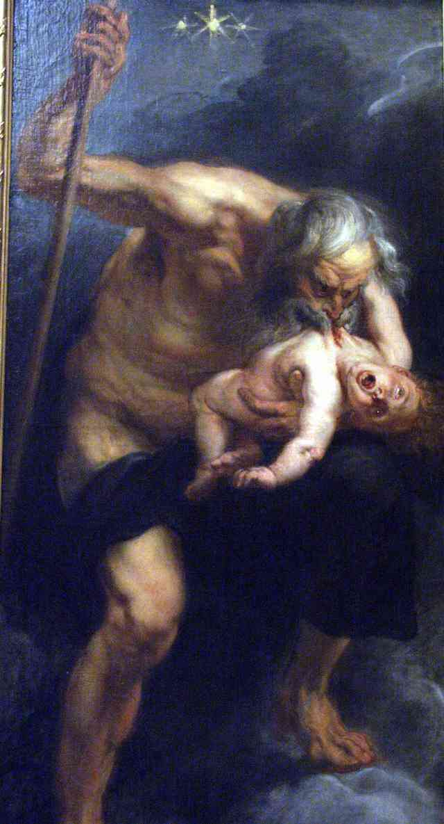
Francisco de Goya (1746-1828)
"Cronus Devouring His Children"
Peter Paul Rubens (1577-1640)
. Cronus devouring one of his children

Slide 2
