Slide 1
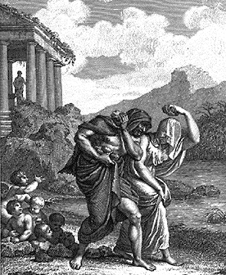
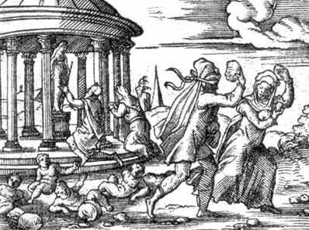
(Deucalion) and Pyrrha

Slide 2
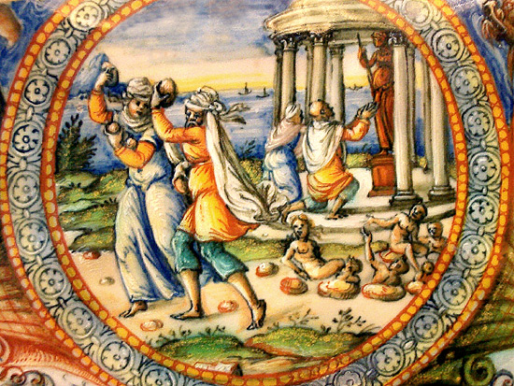
Pyrrha and Deucalion, painted basin, Oraza Fontana or his workshop, 1565-71 Los Angeles, J. Paul Getty Museum.

Slide 3
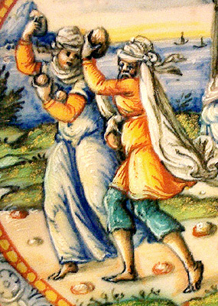
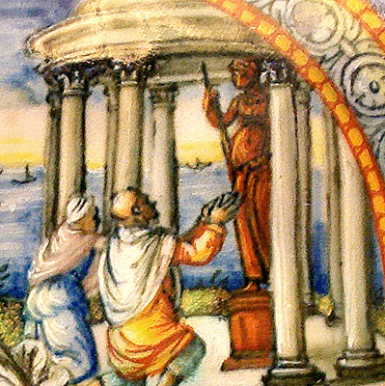
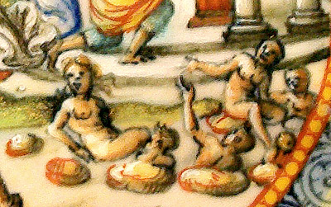

Slide 4
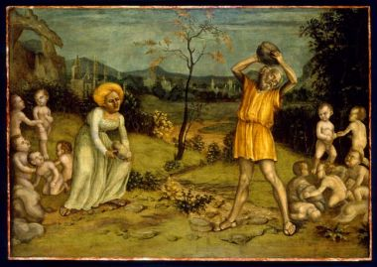
Nicola Giolfino (Italian, 1476–1555) The Myth of Deucalion and Pyrrha, ca. 1550
Tempera on panel 40 ½ x 57 ¾ in. (102.9 x 146.7 cm); frame: 50 ½ x 67 ¼ in. (128.3 x 170.8 cm) Samuel H. Kress Study Collection, 62.159

