Slide 1
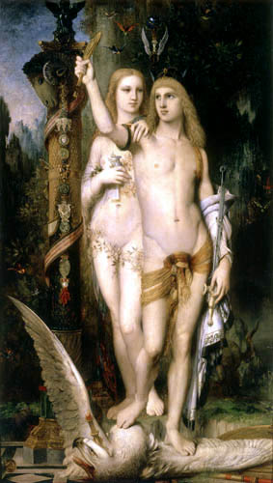
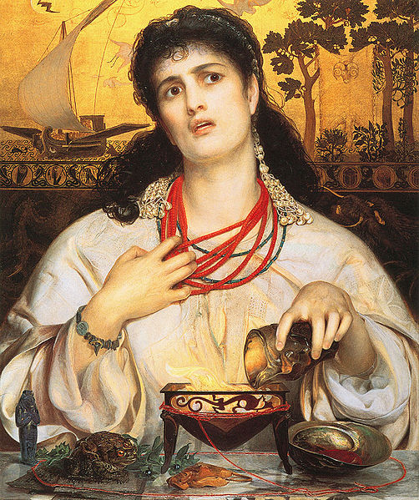
Medea:
Wronged Woman vs. Monster?

Slide 2
Medea in Greek Myth
as Witch
as Barbarian
as Helper
Medea. 1st c. CE Roman copy of a 1st c. BC Greek wall painting. Museo Archeologico Nazionale, Naples.

Slide 3
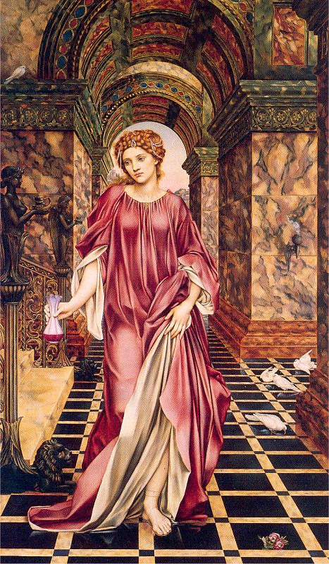
Medea in Modern Myth
as Witch
as Beauty Queen
as Helpless Maiden in Distress
as Strong, Independent Woman
Medea Evelyn De Morgan 1889 Oil on canvas Size: 59 x 35 in Williamson Art Gallery and Museum, Birkenhead, England

Slide 4
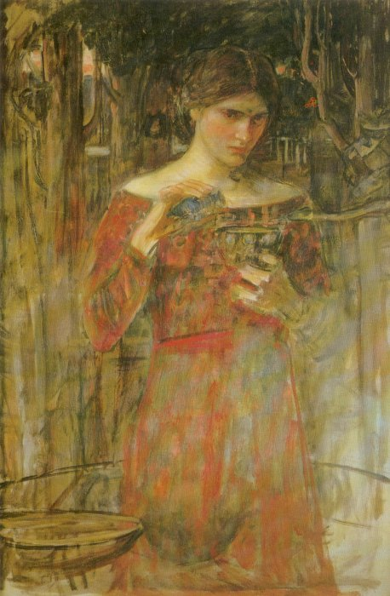
Study for Jason and Medea John William Waterhouse 1907 (?) Oil on canvas Size: 36 x 24 in Private Collection

Slide 5
Anthony Frederick Augustus Sandys
1868

Slide 6
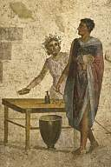
Jason’s Back Story
Aeson
Pelias
Jason

Slide 7
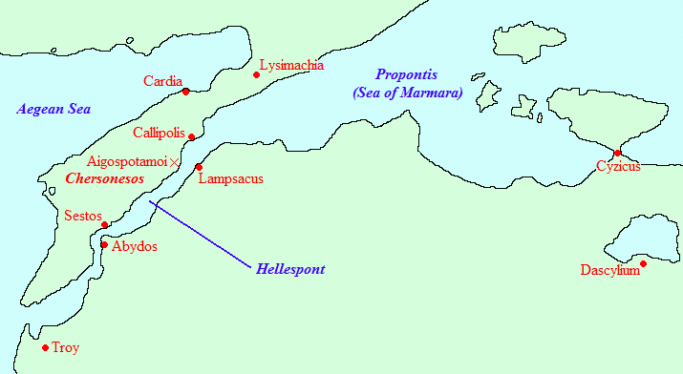
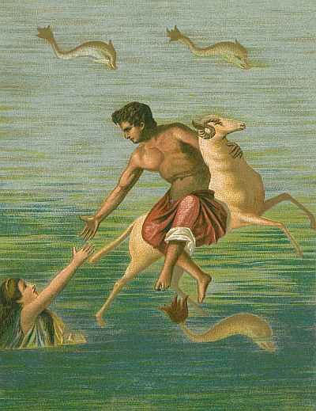
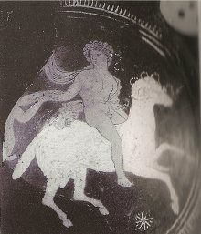
The Golden Fleece
Phrixus
Helle

Slide 8
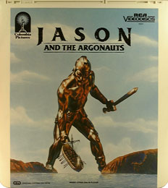
Argonautic Expedition
Argus (builder)
Argo (boat)
Argonaut (sailor)
Argonautica (ancient poem by Apollonius of Rhodes, 3rd cent. B.C.)

Slide 9
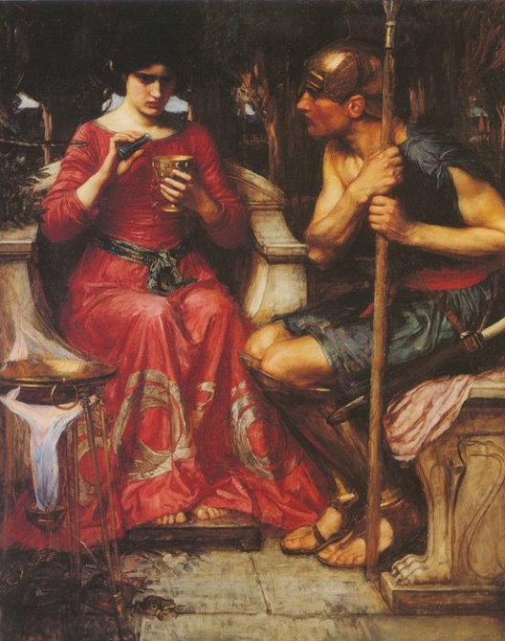
John William Waterhouse
Jason and Medea
1907

Slide 10
Jason and Medea Gustave Moreau 1865

Slide 11
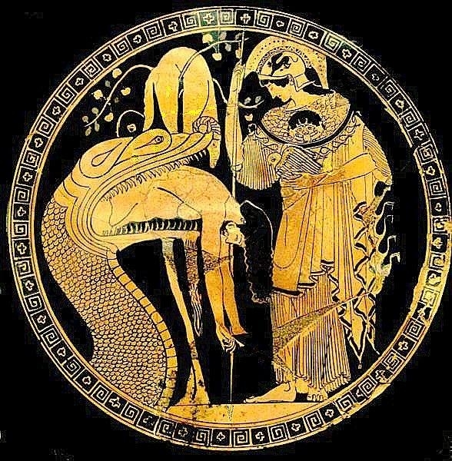
Douris Cup
5th cent. B.C.
Vatican Museum

Slide 12
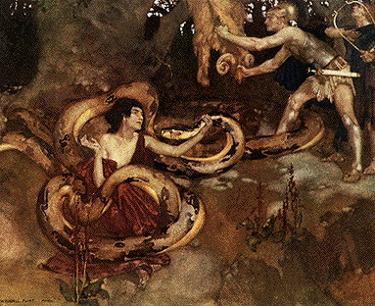
Medea, Jason, Orpheus and the Dragon W. Russell Flint 1910

Slide 13
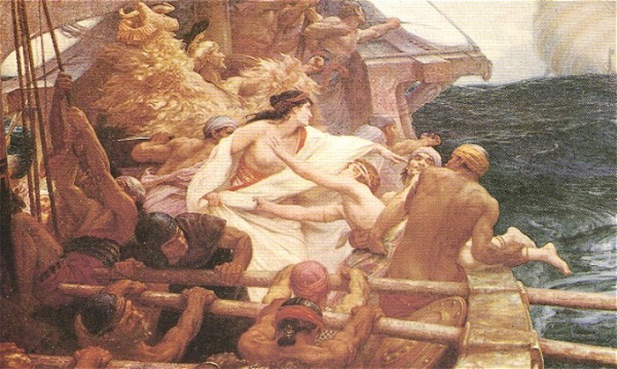
The Golden Fleece Herbert Draper 1904 Oil on canvas Bradford Art Galleries and Museums, Bradford, England
Death of Medea’s brother Aspyrtus

Slide 14
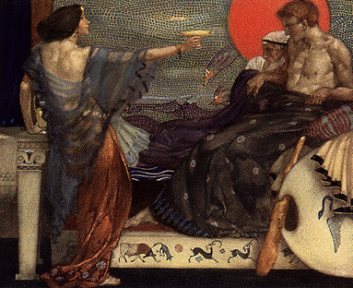
Medea, Theseus and Aegeus W. Russell Flint

Slide 15
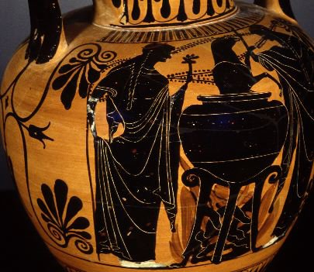
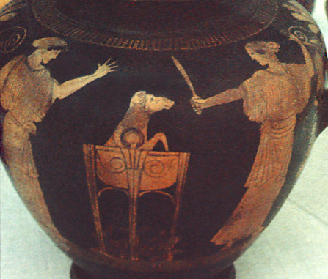
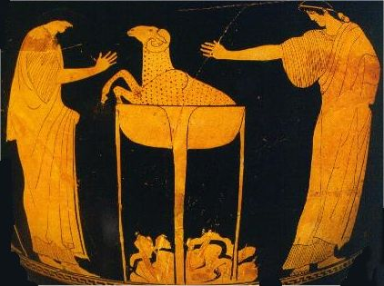
Medea and Pelias
Attic Black Figure, Volci, c.510 B.C.
Harvard 1960.315
detail, red-figure stamnos
Medea and daughters of Pelias with the ram (Medea rejuvenated ram to make the daughters think she would do the same for their father); Greek, c. 470 BCE Berlin, Pergamon Museum. Credits: Barbara McManus, 1992
Attic Red Figure
c.450 B.C.

Slide 16
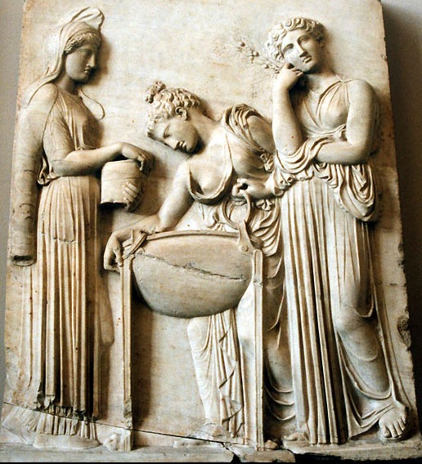
marble relief of Medea and daughters of Pelias preparing the fatal cauldron for their father Roman copy from a fifth-century BCE Athens altar Berlin, Pergamon Museum.

Slide 17
The Magical Earth Maiden
Magical Earth Maiden Pattern
The Magical Earth Maiden Pattern
Earth Maiden Pattern applied to Medea
Compare to Lord Raglan's Hero Pattern

Slide 18
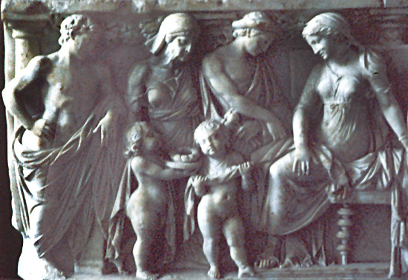
detail, marble sarcophagus—Medea and Jason: left side: nurse and children bring gifts to Creon's daughter while Jason looks on Roman; mid-second century CE Berlin, Pergamon Museum. Credits: Barbara McManus, 1992

Slide 19
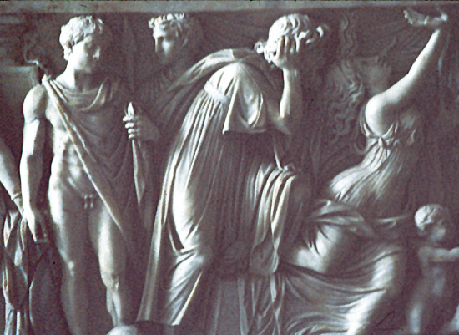
detail, marble sarcophagus—Medea and Jason: center: daughter writhes in pain from poisoned garment while Creon grieves and Jason looks on Roman; mid-second century CE Berlin, Pergamon Museum. Credits: Barbara McManus, 1992

Slide 20
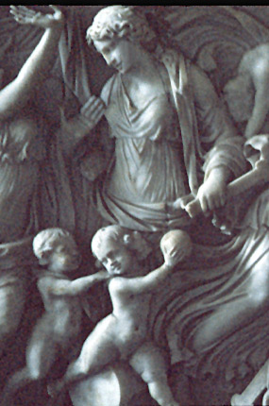
detail, marble sarcophagus—Medea and Jason: right of center: Medea debates whether to kill her children Roman; mid-second century CE Berlin, Pergamon Museum. Credits: Barbara McManus, 1992

Slide 21
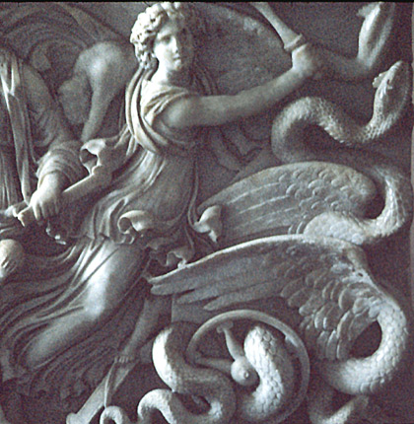
detail, marble sarcophagus—Medea and Jason: far right: Medea escapes in serpent chariot Roman; mid-second century CE Berlin, Pergamon Museum. Credits: Barbara McManus, 1992

Slide 22
Folktale Themes and Medea
Rescue by the Princess
Rescue of the Princess?
Hero’s Betrayal of the Princess
A Women’s Web
A Women’s Wit
Revenge of the Woman Scorned
Danger of the Feminine
Deathly Wedding or Fatal Marriage
Unwanted or Unlucky Gift
Magical Garment

Slide 23
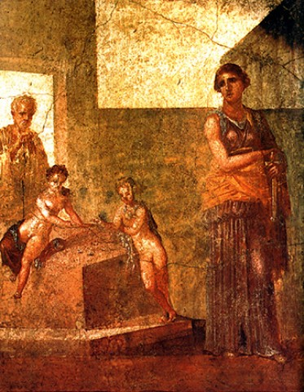
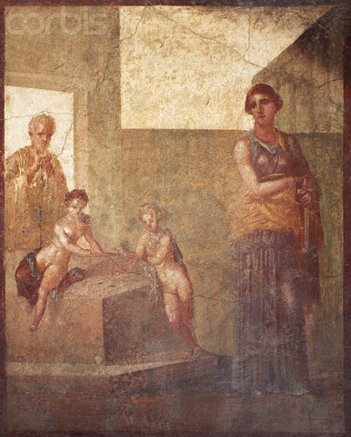
Roman Fresco of Medea and Jason with Their Sons
1st Century B.C.
A fresco painting from Pompeii shows Medea holding a sword while contemplating the murder of her sons.

Slide 24
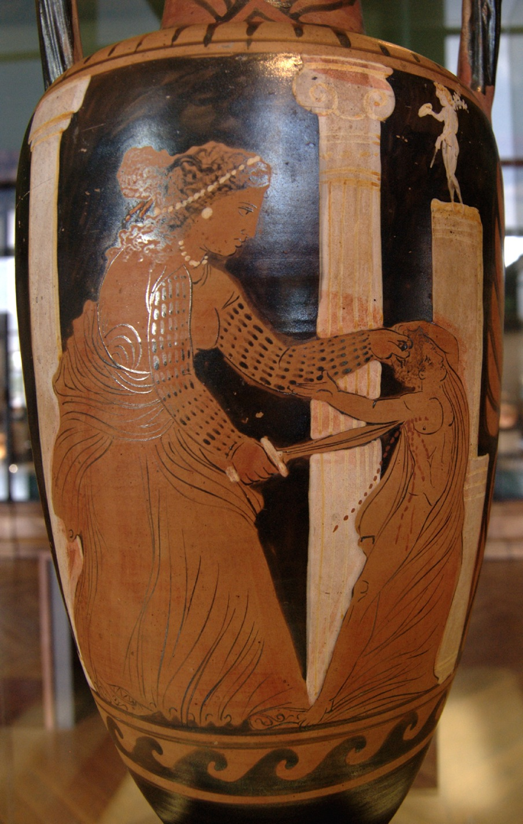
Medea Killing Child
Campanian red-figure neck-amphora
c. 330 BC
Ixion Painter
Musée du Louvre, Paris.

Slide 25
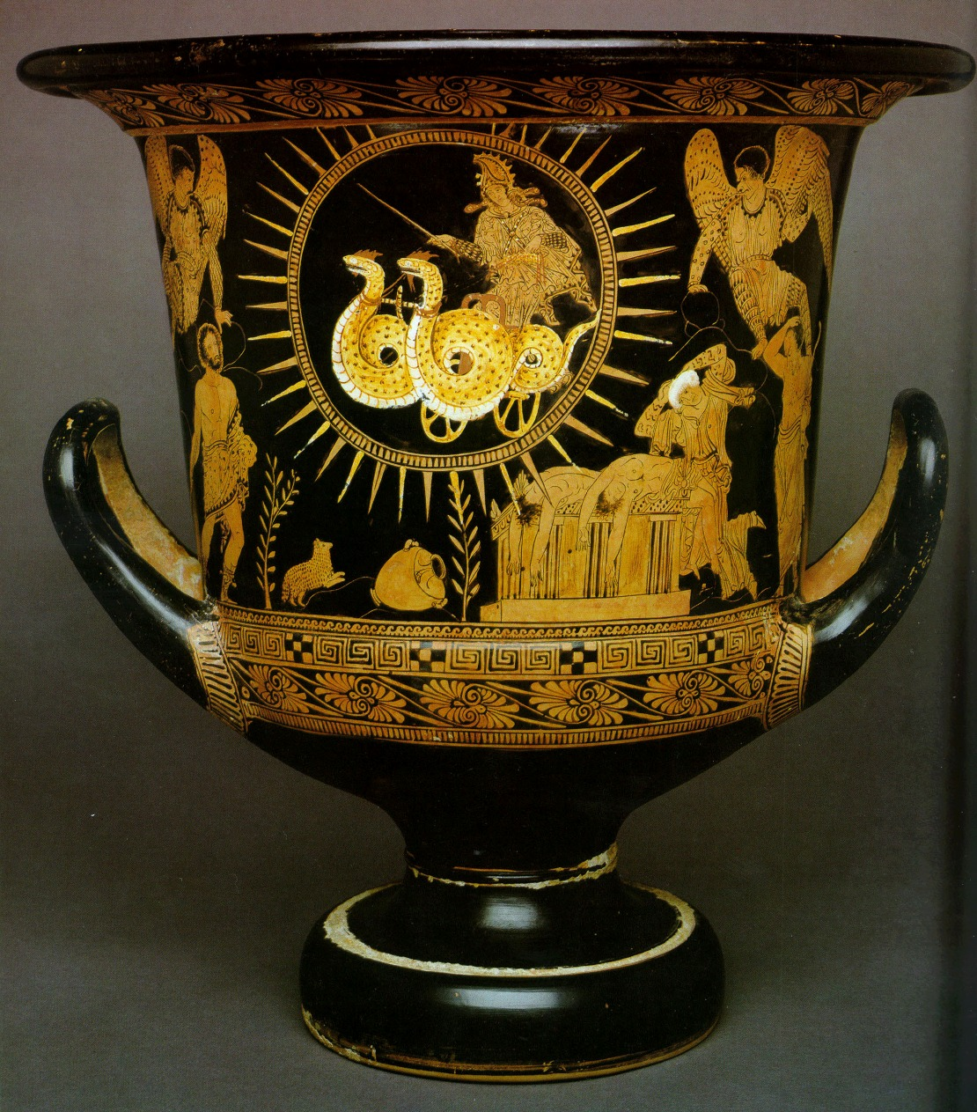
Medea and Chariot
Lucanian calyx krater
c. 400 BC
Cleveland Museum of Art.

Slide 26
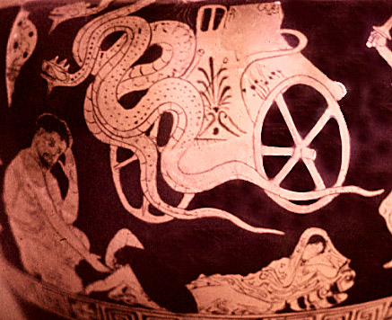
detail, red-figure vase: Medea's serpent chariot and grieving Jason Heraclea Museum. Credits: Paula Chabot, 1982

Slide 27
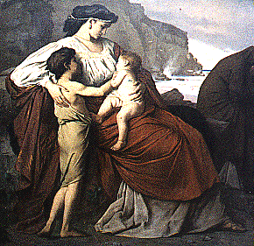
Medea and her children A. Feuerbach (1829-1880) Painting Date: Unknown Medium: Unknown Size: Unknown Neue Pinakotek, Munich

Slide 28
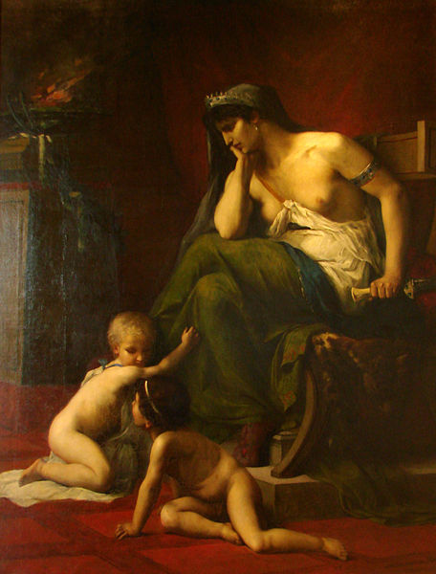
Medea (1868)
Henri Klagmann (1842-1871)
Musée des Beaux-Arts de Nancy

Slide 29
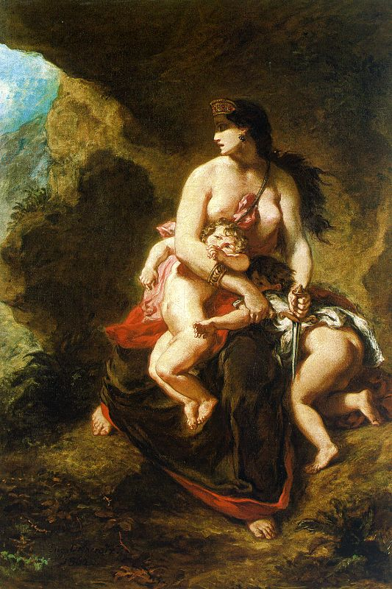
Medea Eugene Delacroix 1838 Oil on canvas Musée du Louvre, Paris

Slide 30
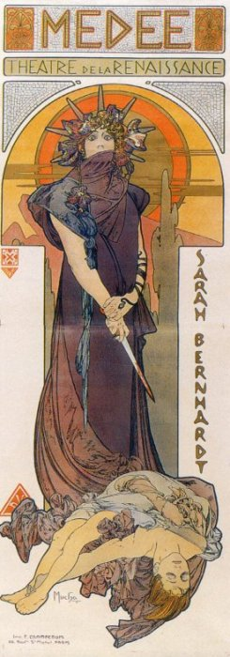
Medea Alfons Mucha 1898 Lithograph 206 x 76 cm Location: Unknown

Slide 31
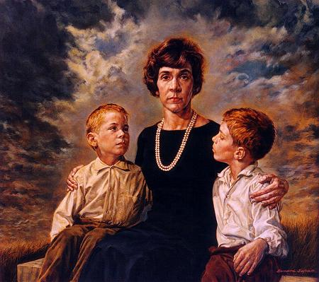
Medea
Bernard Safran
1964 36" x 41", oil on masonite

