Slide 1
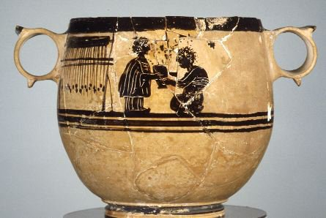
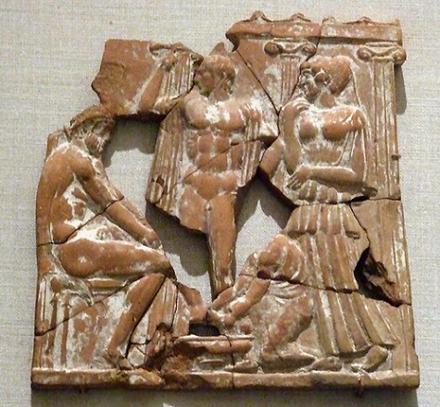
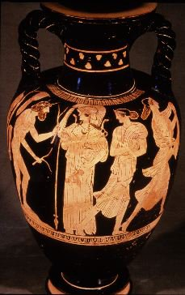
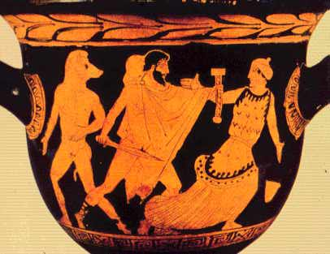
Odysseus’ Other Women

Slide 2
Odysseus’ Other Women
Athena
Calypso
Nausicaa
Circe
Antikleia
Eurykleia

Slide 3
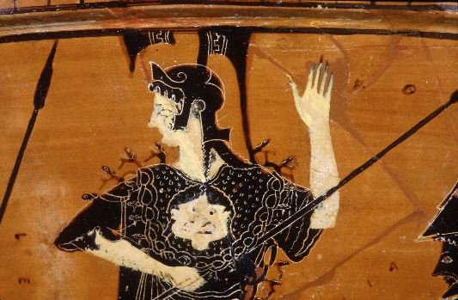
Athena

Slide 4
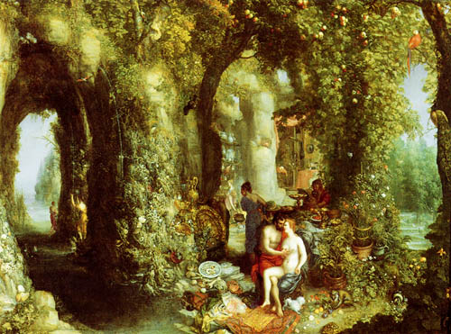
Odysseus and Calypso
Jan Breugel

Slide 5
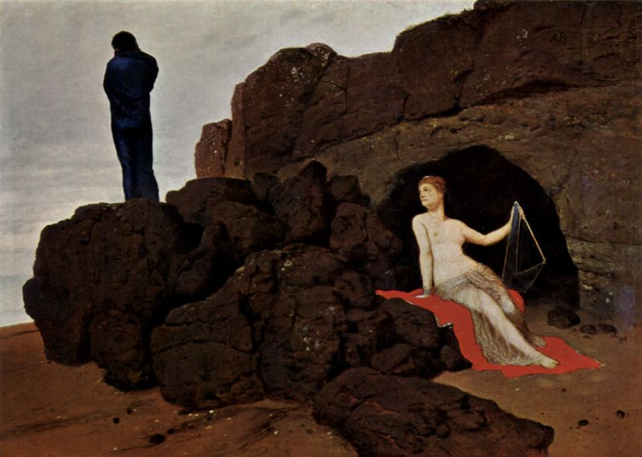
Arnold Bocklin

Slide 6
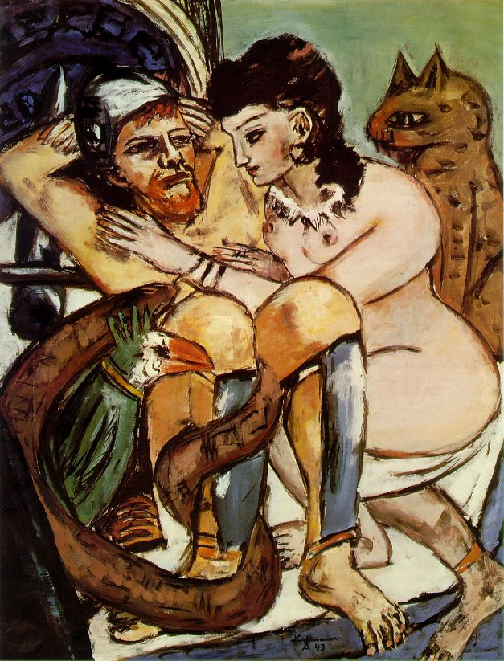
Max Beckman

Slide 7
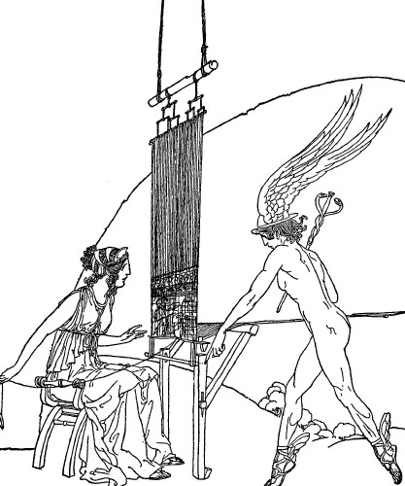

Slide 8
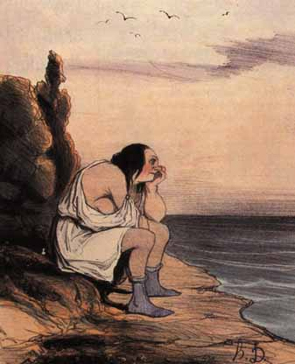
Honoré Daumier 1808-1879

Slide 9
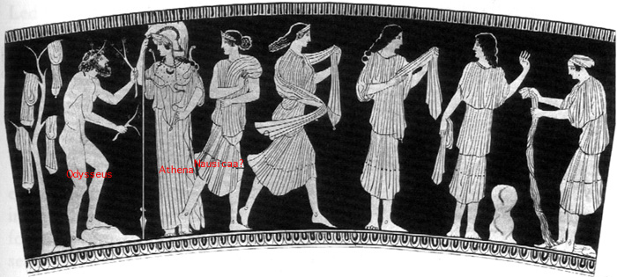
Nausicaa (and Arete)
Name Vase of the Nausicaa Painter
Munich

Slide 10
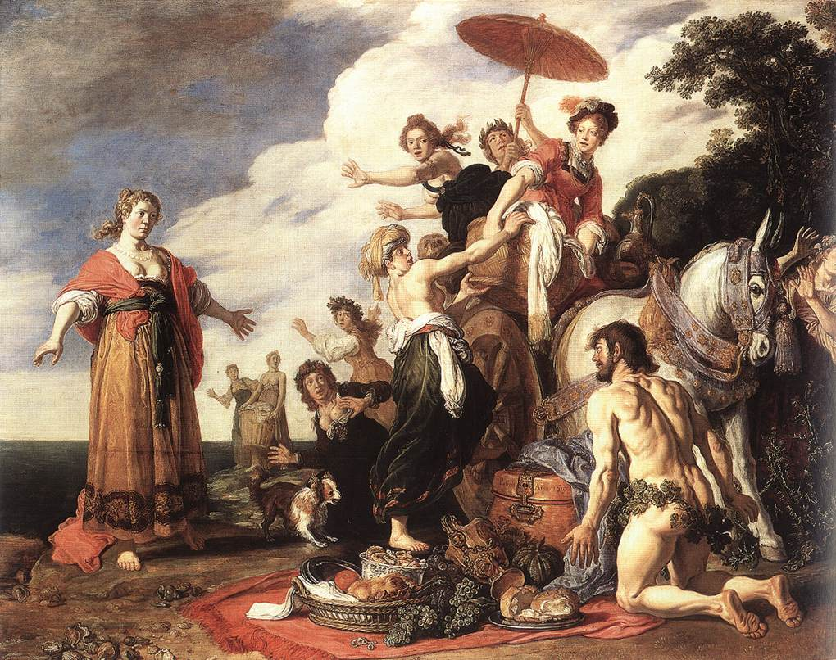
Cristoph Amberger. 1619. Munich

Slide 11
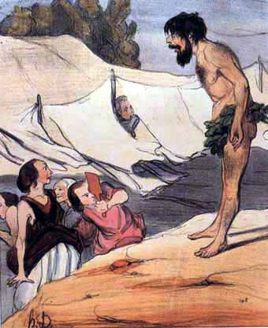
Honoré Daumier 1808-1879

Slide 12
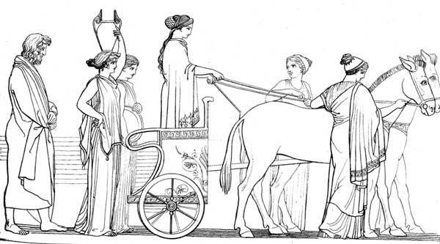

Slide 13
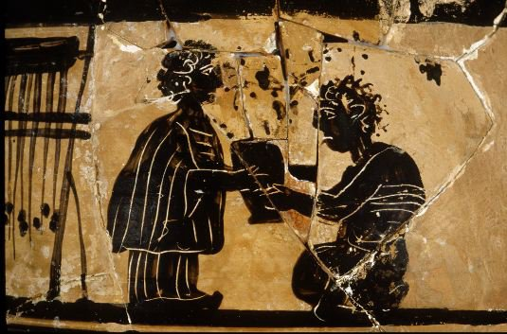
Circe
Beotian Black Figure Vase.
c.450 B.C.
University of Mississippi

Slide 14
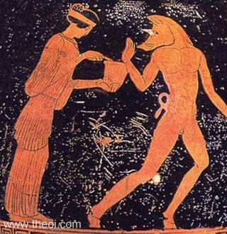
Circe

Slide 15
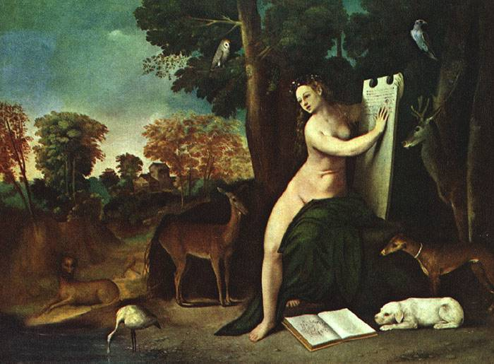

Slide 16
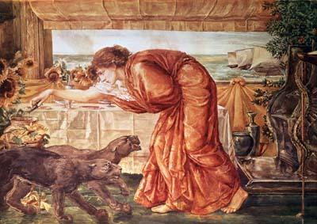
Circe Pouring Poison into a Vase
Burne-Jones

Slide 17
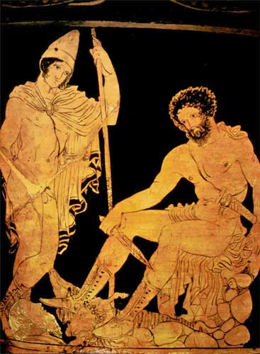
Antikleia

Slide 18
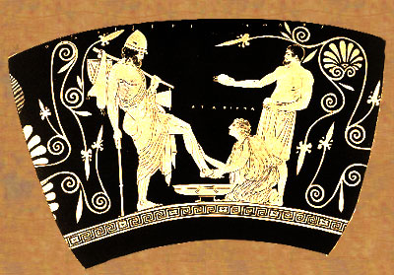
Eurykleia

Slide 19
Odysseus’ Other Women
Athena
Calypso
Circe
Antikleia
Nausicaa
Eurykleia

Slide 20
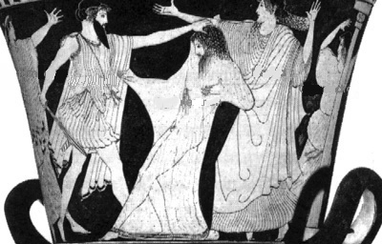
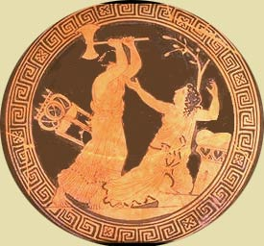
Clytemnestra

Slide 21
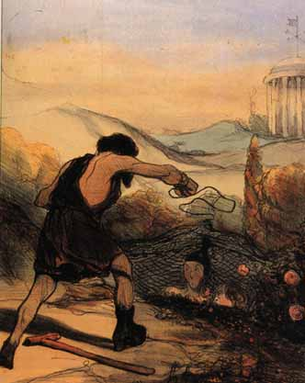
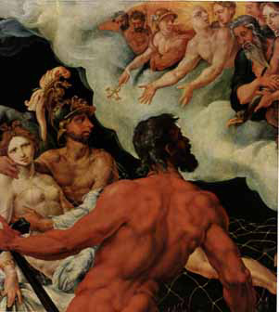
Lay of Demodokos
Ares and Aphrodite being caught in the act by Hephaestus
Martin Van Heemskerk, 1536
Honoré Daumier 1808-1879

