Slide 1
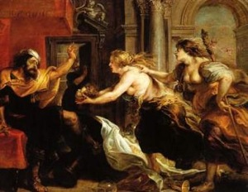
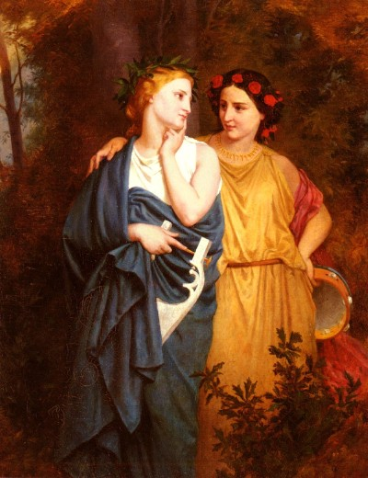
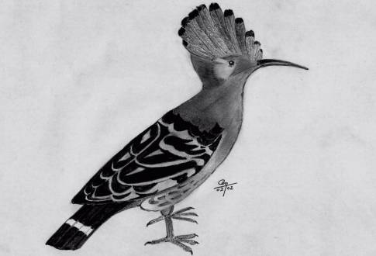
Procne and Philomela

Slide 2
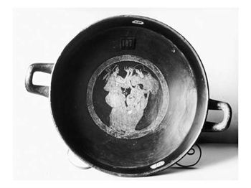
Detail of attic red-figure kylix depicting Philomela, Procne and Itys

Slide 3
Elizabeth Gardener Bourgureau 1837-1932

Slide 4
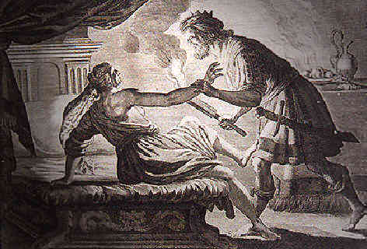

Slide 5
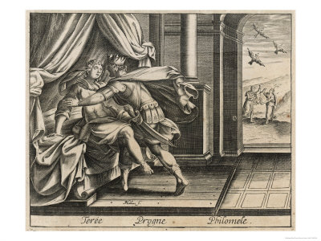
Tereus King of Thrace Wed to Procne Rapes Her Sister Philomela

Slide 6
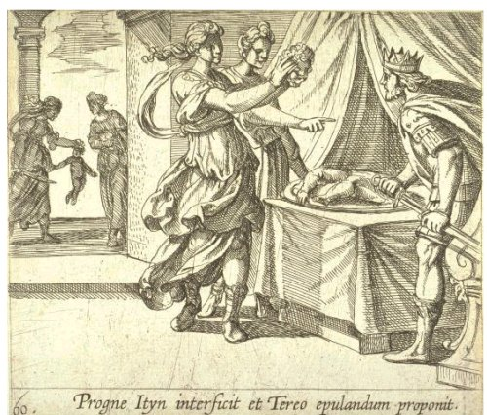
Philomela and Procne showing Itys's head to Tereus. Engraving by Antonio Tempesta for a 16th-century edition of Ovid's Metamorphoses Book VI.

Slide 7
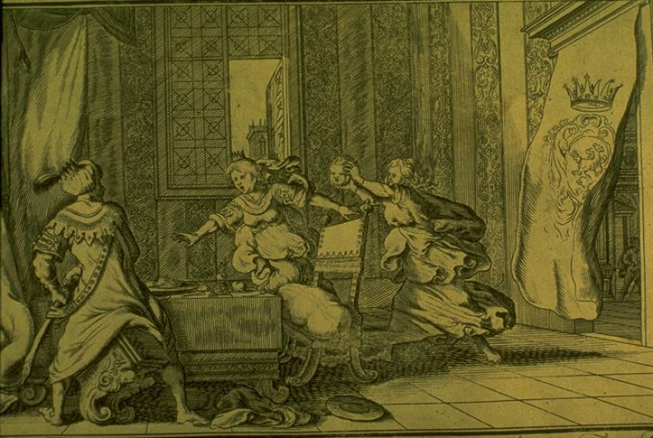
Philomela and Procne showing Itys'head to Tereus. Engraving by Bauer for a 1703 edition of Ovid's Metamorphoses Book VI, 621-647.

Slide 8
Rubens: "Tereus Confronted with the Head of his Son Itys", 1636–1638

Slide 9
Procne & Philomela The Story of the Hoopoe, the Swallow and the Nightingale
Procne, the nightingale, still cries out her lost son's name, "Ity-Ity-Ity", day and night. Philomela, the swallow, lacking a tongue, mutters her rapist's name unintelligibly. And Tereus, the hoopoe, who is still after the two sisters, can be frequently heard yelling "pooh-pooh-pooh" (pou, pronounced "pooh", means where, in Greek).

Slide 10
Influences (from Wikipedia)
Sophocles wrote a tragedy about these events which has been lost, called Tereus.
Philocles also wrote a set of plays about it.
Ovid's story of Philomela from the Metamorphoses was adapted into Old French by the trouvère Chrétien de Troyes in the 12th century.
The nightingale and Itys are referred to in Aeschylus's Agamemnon by Cassandra as she prophesies her own death.^{[2]}
The story of Philomela and Tereus is retold by Chaucer as one of the stories in the fourteenth-century Legend of Good Women.
The story of Philomel is a key plot element in Shakespeare's Titus Andronicus. Prominent allusions to Philomel also occur in The Rape of Lucrece, and the story is also referred to in Cymbeline.
T. S. Eliot's poem The Waste Land has a number of mentions and allusions to this myth.
The Nymph's Reply to the Shepherd, a poem by Sir Walter Raleigh, mentions Philomel in the second stanza.
Timberlake Wertenbaker wrote a play about this myth called The Love of the Nightingale; she also wrote the libretto for Richard Mills's opera of the same name.
In The Birds by Aristophanes, the head Hoopoe represents Tereus.
The poem Philomela by English poet Matthew Arnold, makes numerous allusions to the myth, centering around a crying nightingale.
Ted Leo and the Pharmacists reference Philomel in their song 2nd Ave, 11 AM, from Hearts of Oak.
Hanoch Levin wrote a play heavily influenced by the myth, named The Great Whore of Babylon.
Samuel Taylor Coleridge wrote a poem called The Nightingale which mentions Philomela as a contrast to the song of the Nightingale.
José Rizal wrote a dedication called Felicitation, which names Philomela in a metaphor to his commitment to send salutations to his brother-in-law Antonino Lopez.
Jeannine Hall Gailey wrote several poems based on the myth that appear in her book Becoming the Villainess: "Remembering Philomel," "Philomel's Rape," "On Rubens' 'Tereus Confronted with the Head of His Son Itylus,'" "Case Studies in Revenge: Philomel Gives Some Advice," and "Procne and Philomel, At the End."
In Walter Wangerin, Jr.'s The Book of Sorrows, the brown bird, who Wyrm solicits for his suicide and whose tongue he cuts out, says nothing but "jug jug" and "tereu."
In Margaret Atwood's The Tent there's a short novel titled Nightingale, where the two sisters discuss the incident, and their names are reversed in it.

