Slide 1
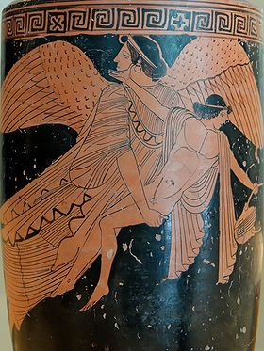
Seduction and Rape

Slide 2
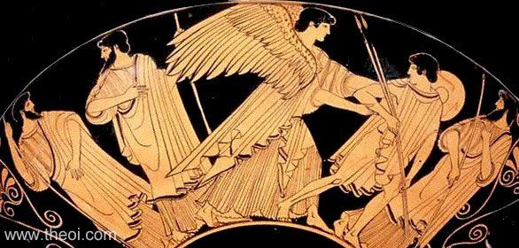
EOS & KEPHALOS
Museum Collection: The J Paul Getty Museum, Malibu, California, USA Catalogue Number: Malibu 84.AE.569 Beazley Archive Number: 16200 Ware: Attic Red Figure Shape: Kylix Painter: Douris Date: ca 480 BC Period: Late Archaic / Early Classical
Oionokles Painter
Eos carrying away young Kephalos (named); kalos inscription (here unseen). Belly of an Attic red-figure lekythos, ca. 470–460 BC.

Slide 3
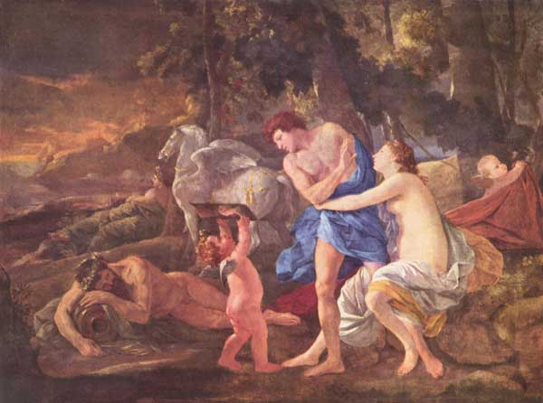
Cephalus and Aurora (Eos), by Nicolas Poussin, (c. 1630), 96,5 × 130,5 cm , National Gallery , London

Slide 4
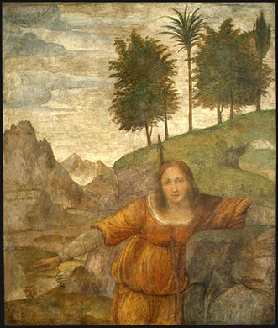
Bernardino Luini Procris Pierced by Cephalus' Javelin, c. 1520/1522 Samuel H. Kress Collection 1943.4.56

Slide 5
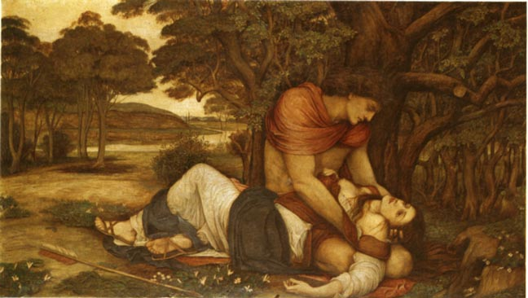
Procris and Cephalus by John Rodham Spencer Stanhope (1829-1908). Exhibited R. A. 1872. 37 1/2 x 66 inches
Ovid’s Metamorphoses 7

Slide 6
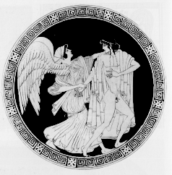
Kylix by the Telephos Painter.
Eos taking hold of Tithonus
Museum of Fine Arts, Boston

Slide 7
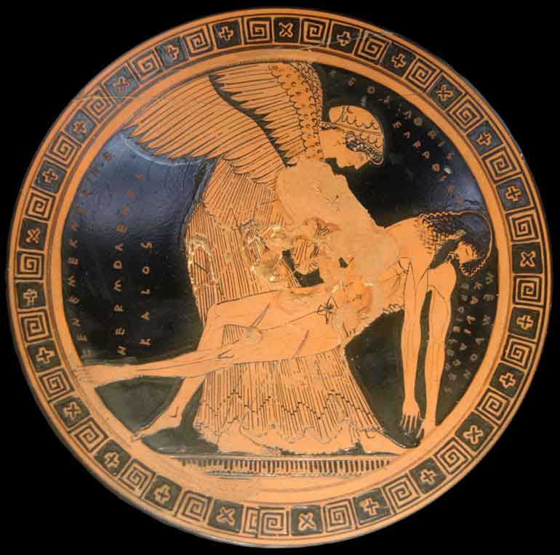
Eos and Memnon, Douris Painter, Louvre G 115

